Slide 1
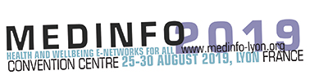




Clinical Text Mining on FHIR
Philipp Daumkeª, Kai U. Heitmann^{b,c}, Simone Heckmann^{b,c}, Catalina Martínez-Costa^{d}, Stefan Schulz^{a,d}
ª Averbis GmbH, Freiburg, Germany,
^{b} Gefyra GmbH, Hürth, Germany,
^{c} HL7 Germany, Berlin, Germany
^{d} Institute for Medical Informatics, Statistics and Documentation,
Medical University of Graz, Austria

Slide 2



To build software that aims at removing the differences between structured and unstructured data
FIND
UNDERSTAND
PREDICT
Turn text into actionable information
Understand and automate cognitive processes
Enable better
business critical decisions

Slide 3
To build software that aims at removing the differences between structured and unstructured data
Natural language processing (NLP)
Information extraction:
FIND
UNDERSTAND
PREDICT
Turn text into actionable information
Understand and automate cognitive processes
Enable better
business critical decisions

Slide 4
To build software that aims at removing the differences between structured and unstructured data
Natural language processing (NLP)
Information extraction:
Klinischer Befund:
72-jährige Patientin in ausreichendem AZ, Körpergröße 1,57 m, Körpergewicht 72,8 kg. Haut und sichtbare Schleimhäute gut durchblutet. Kein Ikterus, keine Zyanose. Mundhöhle o.B.. Keine Struma, keine peripheren Lymphknotenschwellungen. Über Herz und Lungen war der klinische Befund unauffällig. RR bds. 160/80 mm Hg, Pulsfrequenz regelmäßig. Leber und Milz nicht vergrößert. Nierenlager klopfschmerzfrei. Keine Varizen, keine Oedeme. Fußpulse beiderseits tastbar. MER seitengleich.
FIND
UNDERSTAND
PREDICT
UNDERSTAND
PREDICT
NLP
Understand and automate cognitive processes
Enable better
business critical decisions
Turn text into actionable information
Understand and automate cognitive processes
Enable better
business critical decisions
Text (unstructured / semistructured) Information template

Slide 5

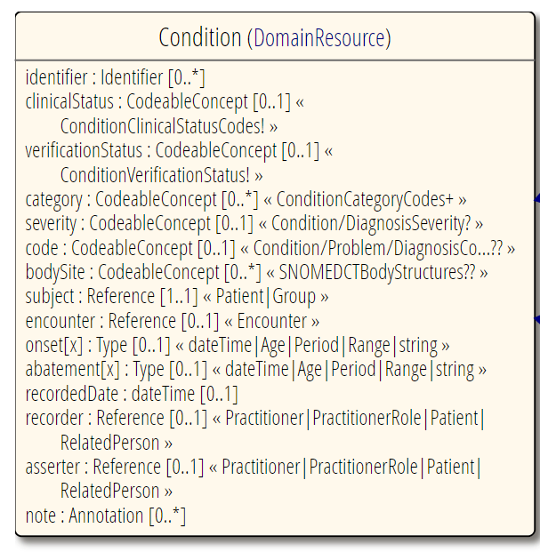
Information Model Standard: HL7 FHIR
Resources:
  data model components
  defining sets of properties
  that describe structures
  for data acquisition
  models for frequently occurring
  documentation and information
  exchange tasks
Examples:
  MedicationRequest
  AdverseEvent
  Procedure
  Condition
https://www.hl7.org/fhir

Slide 6
Focus of the Work
Klinischer Befund:
72-jährige Patientin in ausreichendem AZ, Körpergröße 1,57 m, Körpergewicht 72,8 kg. Haut und sichtbare Schleimhäute gut durchblutet. Kein Ikterus, keine Zyanose. Mundhöhle o.B.. Keine Struma, keine peripheren Lymphknotenschwellungen. Über Herz und Lungen war der klinische Befund unauffällig. RR bds. 160/80 mm Hg, Pulsfrequenz regelmäßig. Leber und Milz nicht vergrößert. Nierenlager klopfschmerzfrei. Keine Varizen, keine Oedeme. Fußpulse beiderseits tastbar. MER seitengleich.
NLP
Harmonization of clinical text mining output with FHIR.
Identification of gaps in the current FHIR specification related to content essential for text mining.
Introduction of FHIR extensions that allow text mining results to be represented without loss.

Slide 7
UIMA
Unstructured Information Management Architecture (UIMA):
flexible and extensible text-mining framework
All elements extracted from texts are predefined by Type systems:
  Defines attributes and features
  Common UIMA type: “Annotation: Attributes “begin” … “end” specify a sequence of characters in a text to which the annotation relates
Currently no UIMA type system specific to healthcare
Bridging the gap between UIMA type system and FHIR:
  Defining a FHIR-compatible type system (as output of the NLP system)
  Exposing a FHIR compatible interface

Slide 8

FHIR-compatible interface for text mining results
Which are the right FHIR resources and containers to return a text mining result?
How can document text annotations referring to clinical conditions and observations be linked together?
How can two important text mining features, be specified in FHIR
  (i) text span of an annotation
  (ii) its confidence score
How can the types of the text mining system be mapped to FHIR resources and which challenges occur?

Slide 9
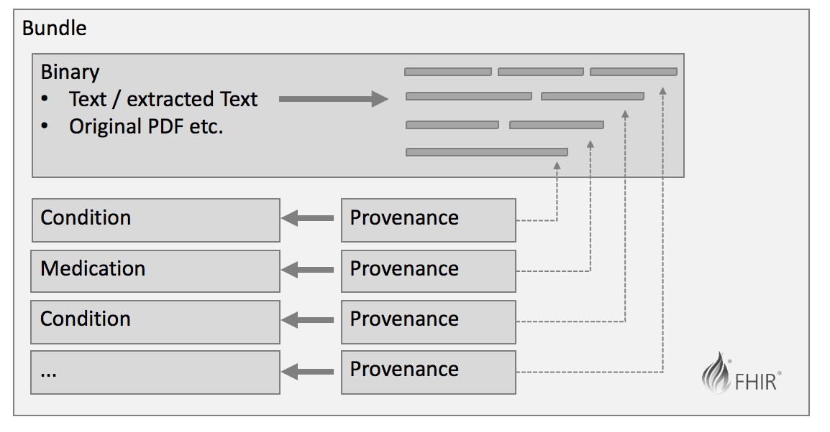
Results (I):
FHIR resources and container for text mining results
Text mining system processes documents (e.g. PDF) and returns extracted text with annotations
Appropriate FHIR
structure:
  Bundle of type collection,
  grouping
    Original document (Binary)
    FHIR resource(s), filled by
    information extracted from
    the original document
Provenance resource
  Specifying data source, extraction agent (here NLP system) and target resource

Slide 10
Results (II): FHIR extensions Character Range and confidence
character-range specifies the place in a source text to which an annotation belongs
  "extension": [{"url": "http://example.com/StructureDefinition/character-range/0.9",
  "valueRange": [{"low": {"value": 201, "unit": 1},
  "high": {"value": 219, "unit”: 1}}]}]
confidence specialises the type Quantity, stating the accuracy of annotations
  "extension": [{"url": "http://example.com/StructureDefinition/confidence/0.9",
  "valueQuantity": {"value": 0..1}}]

Slide 11
Results (III): Mapping the text mining Output to FHIR Resources
Averbis Health Discovery | FHIR Resource
Diagnosis | Condition
.concept* | .code*
.clinicalStatus | .clinicalStatus
.verificationStatus | .verificationStatus
.belongsTo | .subject.display
.side | .bodySite.text
Medication | Medication
.drug.ingredientConcept* | .ingredient*
.doseForm* | .form*
 | MedicationStatement
.status | .status
.drug.strength.value | .dosage.doseQuantity.value
.drug.strength.unit | .dosage.doseQuantity.unit
.doseFrequency** | .dosage.timing**
.administrations* | .dosage.method*
LaboratoryValue | Observation
.parameter* | .code*
.fact.value | .valueQuantity.value
.fact.unit | .valueQuantity.unit
.interpretation | .interpretation.text
.upperLimit.normalizedValue | .referenceRange.high.value
.upperLimit.normalizedUnit | .referenceRange.high.unit
.lowerLimit.normalizedValue | .referenceRange.low.value
.lowerLimit.normalizedUnit | .referenceRange.low.unit
(*) (codable) concept
(**) not yet further specified

Slide 12
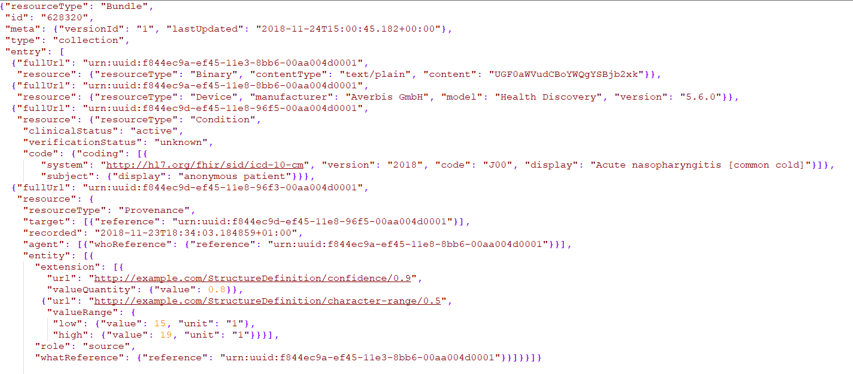
Example „The patient has a cold“

Slide 13
Conclusion
Proof of concept of alignment between UIMA based NLP type system and FHIR resources
Modelling solution for additional NLP-relevant information as a FHIR bundle, addressing data provenance and data quality
Necessary extensions to the FHIR standard currently being processed by the international HL7/FHIR committee

Slide 14
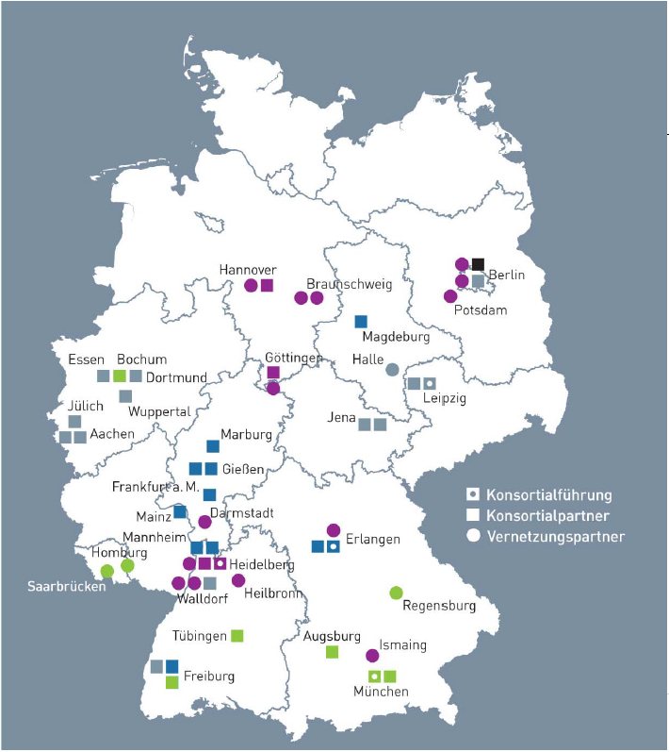




Contact
Philipp Daumke
Averbis GmbH
Freiburg, Germany
philipp.daumke@averbis.com
Acknowledgements
Averbis is the text mining partner in currently three consortia of the German „Funding Scheme Medical Informatics“
(Federal Ministry of Education and Research (BMBF) within the Medical Informatics Funding Scheme (FKZ 1ZZ1606A and 01ZZ1609A).

