Slide 1

Fourth Interdisciplinary School on Applied Ontology (ISAO 2018)
10-15 September 2018, Cape Town, South Africa
Biomedical Ontologies
Stefan
Schulz
M e d i c a l
University
o f G r a z
(A u s t r i a)
purl.org/steschu
steschu@gmail.com

Slide 2
Goals of the lectures
Data management in biomedical research and health care
Overview of the entities of interest this area
Practice “ontological thinking”
Catch up with previous knowledge on ontology and logic
Discuss specific ontological challenges in this domain
Distinguish ontologies from other semantic artefacts

Slide 3
The scope: biomedical research & health care
Health
  Crucial resource for well being
  More than absence of disease
Health care / medicine:
  one of the world's largest and fastest-growing industries
  > 10 percent GDP of most developed countries
Beyond care:
  health involves all aspects of life, e.g. diet, exercise, occupational safety
Beyond humans: veterinary medicine

Slide 4
The scope: biomedical research & health care
Biology
  Science that studies life and living organisms
  Genes → Molecules → Cells → Organisms → Populations →Ecosystems
Biomedical Science:
  Application of biology and other natural science for diagnosis, prevention and treatment of diseases
  Important application: pharmaceutical industry
    total pharmaceutical revenues worldwide > 1 Trillion $
    Cost of bringing new drug to market: > 1 Billion $

Slide 5
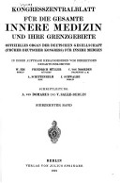
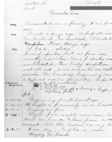
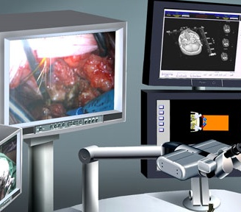
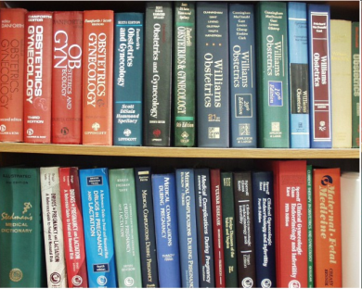


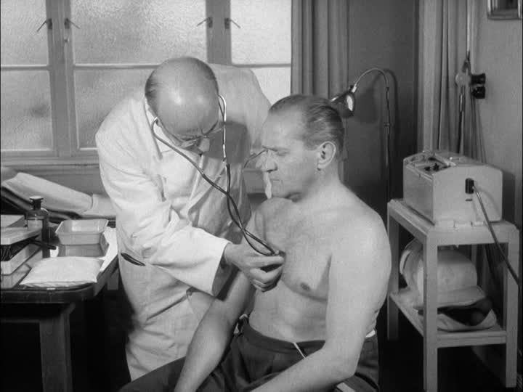


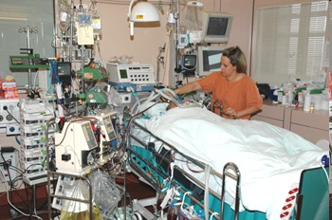


Data in health care
What has changed since then?

Slide 6
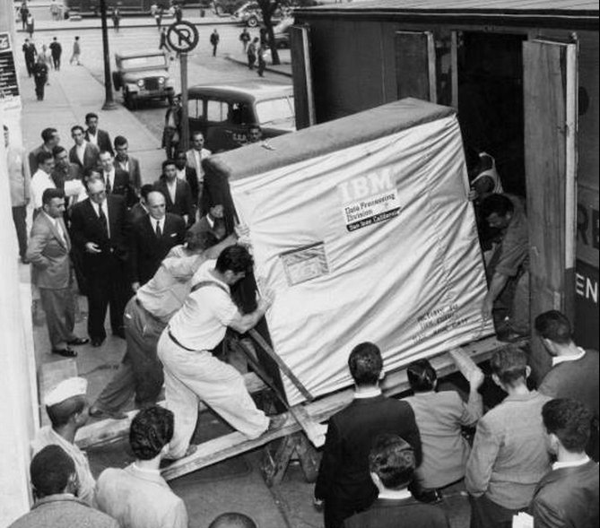
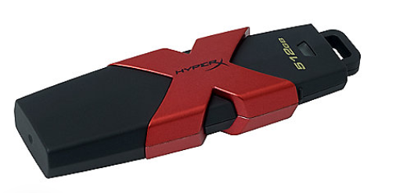
Technology (r)evolution
5 MB IBM Hard Drive, 1956 * 100,000 512 GB Memory Stick 2018

Slide 7
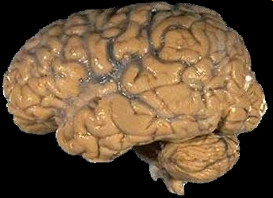
Human evolution
Human brain 1956 Human brain 2018

Slide 8
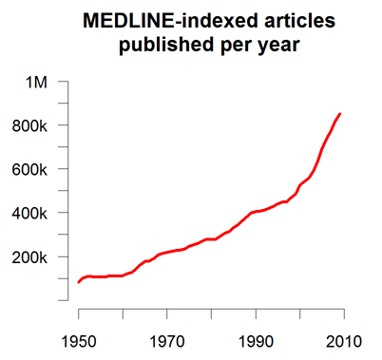
Knowledge explosion

Slide 9
Data in health care
Electronic health records
  Substitute of traditional paper chart
  Serve different purposes
  Documenting the patient‘s history and progress
    Legal requirements
    Communication between physicians, nurses
  Coding for billing / reimbursement
  Special documentation
    Clinical trials
    Patient registries
    Quality control

Slide 10
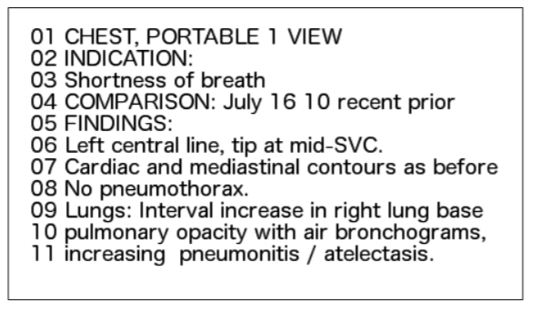
Most clinical data is free text
St. p. TE eines exulc. sek.knot.SSM li US dors. 5/11 Level IV 2,4 mm Tumordurchm. Sentinnel LK ing. li. tumorfr.
Planning Nieuwe afspraak binnen 6 maanden met vroegere voorafgaande adipositascontroles . De patïente moet ook PTH , folaten en cobalamine laten controleren bij labo - onderzoeken , ze doet die zelf aangezien ze verpleegster is in de provindie provincie Skåne . Moet de inname van calciumtabletten naar 3 per dag verhogen ( momenteel slechts een per dag ). Binnen 3 maanden nieuwe controle van 25- OH - vitamine D3- controle , inclusief PTH en vloeistofhuishouding . Code diagnose / behandeling Hoofddiagnose : Z090, halfjaarlijkse controle na gastric bypass wegens obesitas
Paciente cardiopatia isquemico, com CRM prévia, interna para realizar ACTP + stent em ACD, via ponte de safena. Procedimento realizado com sucesso e sem intercorrências.
Which are the advantages / disadvantages of free text in clinical documentation?

Slide 11
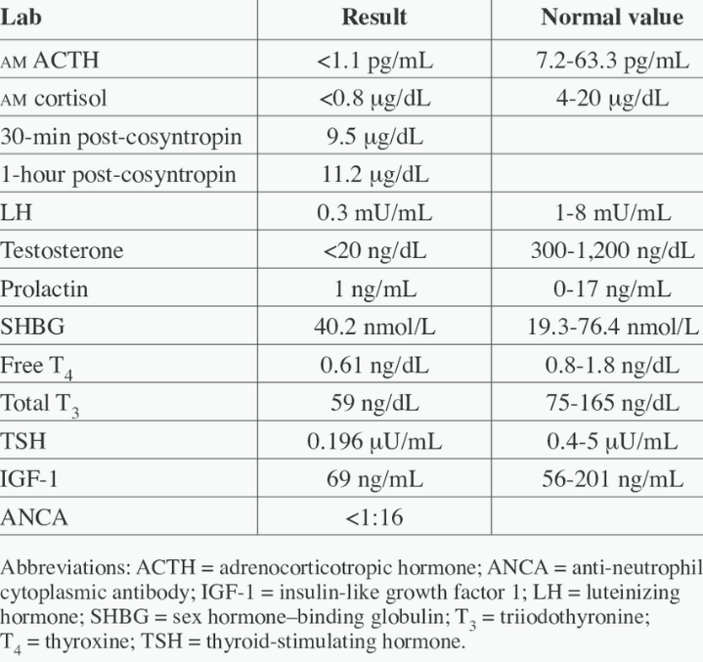
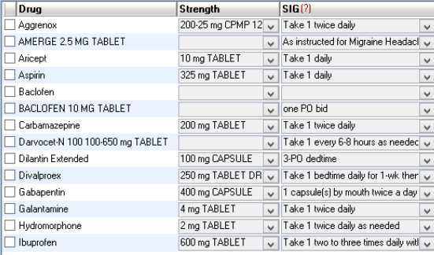
Structured clinical data
Lab results Drug prescriptions
http://www.lrec-conf.org/proceedings/lrec2016/pdf/1222_Paper.pdf
http://www.neurologyemrsoftware.com

Slide 12
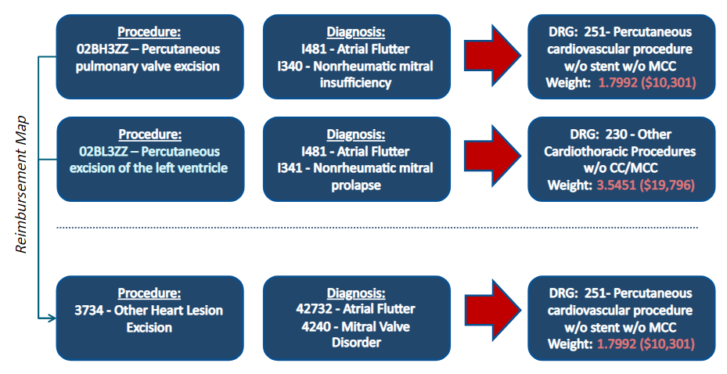
Abstracted, coded data (I)
Data for billing / reimbursement
U.S. Centers for Medicare & Medicaid services https://slideplayer.com/slide/2686045/
Motivation to produce these data? Sources of bias ?

Slide 13
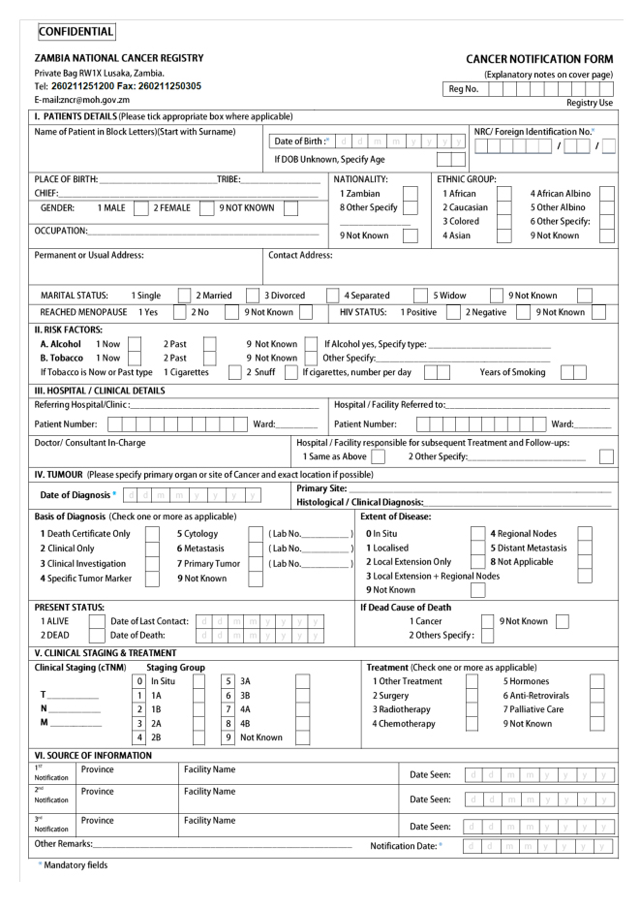
Abstracted, coded data (II)
Data for epidemiology: example cancer registry
What’s the interest of physicians to fill such forms on paper or on screen?
http://afcrn.org/images/M_images/attachments/135/Zambia%20data%20collection%20form%20copy.jpg

Slide 14
Quality problems with clinical data
Textual data relatively accurate and complete, tailured to human readers but difficult do analyze: NLP (natural language processing systems) have to deal with multiple sublanguages and poor editing
Structured data often not linked to international semantic standards (controlled vocabularies, ontologies)
Limited motivation to generate good quality data:
  Wherever users are not beneficiaries of data
  Wherever users have to record data redundantly
Known biases:
  Collecting data for billing / reimbursement
  Collecting data for quality management

Slide 15
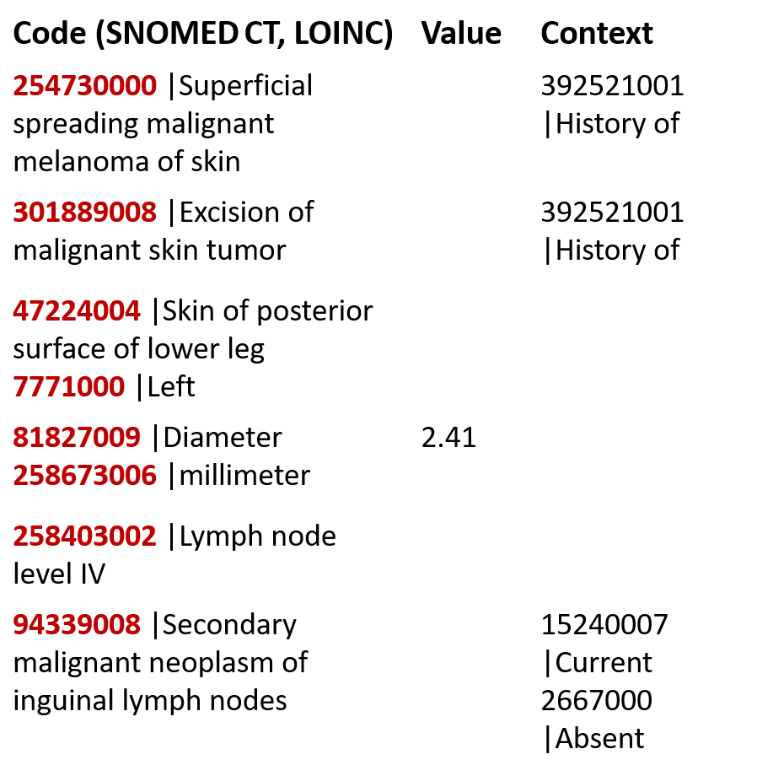
The holy grail of medical informatics…
St. p. TE eines exulc. sek.knot.SSM li US dors. 5/11 Level IV 2,41 mm Tumordurchm. Sentinnel LK ing. li. tumorfr.

Slide 16
Primary and secondary use scenarios
Primary use: documenting, communicating, collecting specific data for defined data analysis use cases
Secondary use: Repurposing of clinical routine data, e.g. for
  Building cohorts for clinical trials
  Retrospective data analysis
  Medical education
  Prediction of future events
Where do you think ontologies come into play ?

Slide 17
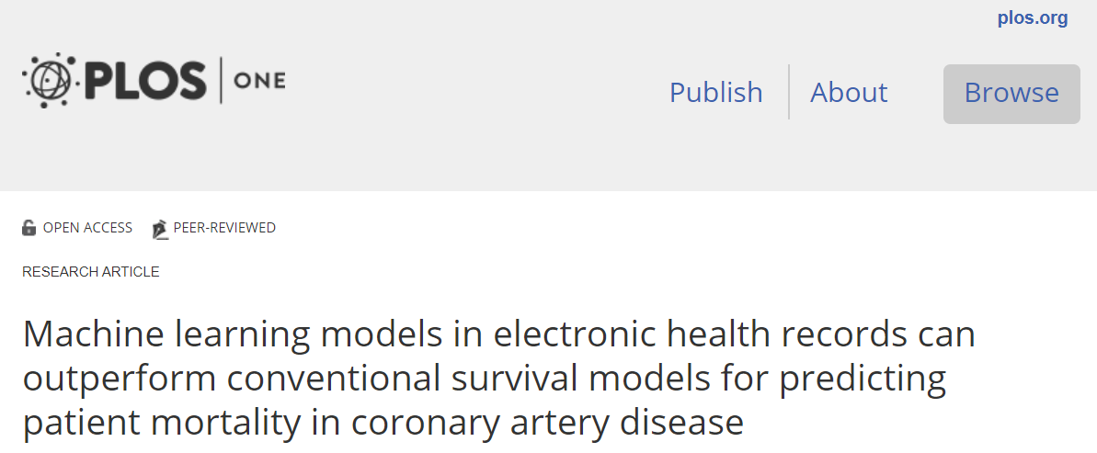
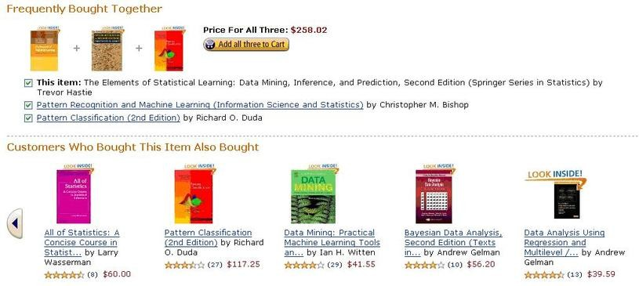
Primary and secondary use scenarios
What does this have in common?
Is there a need for ontologies?

Slide 18
Privacy of clinical data
Hippocratic oath:
“And whatsoever I shall see or hear in the course of my profession (…) I will never divulge, holding such things to be holy secrets”
Declaration of Helsinki
“It is the duty of physicians who are involved in medical research to protect the life, health, dignity, integrity, right to self-determination, privacy, and confidentiality of personal information of research subjects”
Health profession council of South Africa:
“Health care practitioners hold information about patients that is private and sensitive. The National Health Act (Act No. 61 of 2003) provides that this information must not be given to others, unless the patient consents or the health care practitioner can justify the disclosure. Practitioners are responsible for ensuring that clerks, receptionists and other staff respect confidentiality in their performance of their duties. “
https://history.nih.gov/research/downloads/hippocratic.pdf
http://www.who.int/bulletin/archives/79%284%29373.pdf
http://www.hpcsa.co.za/downloads/conduct_ethics/rules/confidentiality_protecting_providing_info.pdf

Slide 19
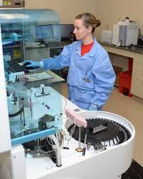
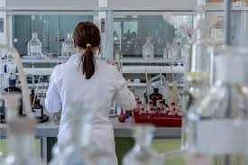
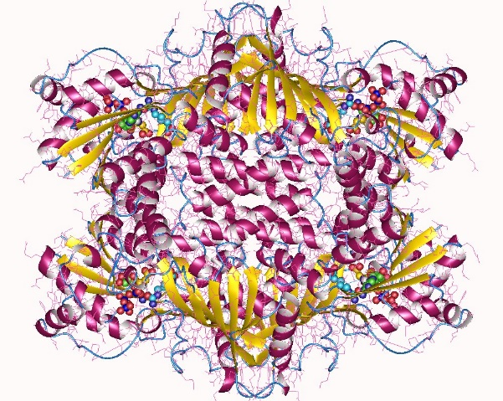
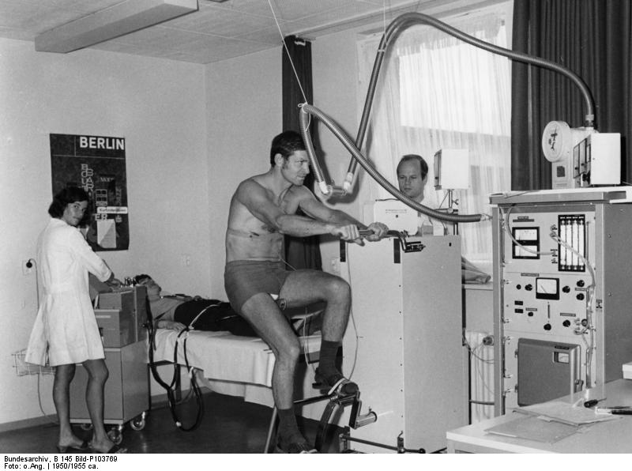
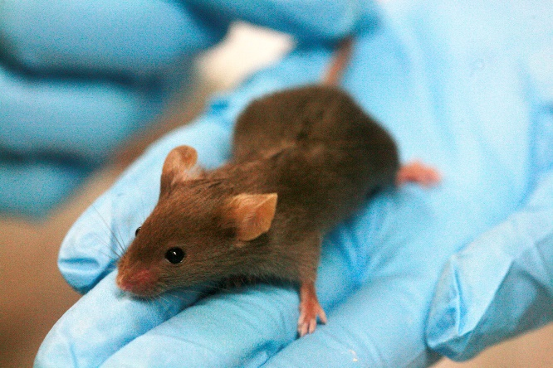
Data in biomedical sciences
What do you think is different compared to clinical data?

Slide 20
Data in biomedical sciences
Experiments require precise documentation
  Clinical trials use own data acquisition standards and tools
  Lab experiments increasingly publish not only papers but also datasets
  Primary source of scientific data peer-reviewed publications

Slide 21
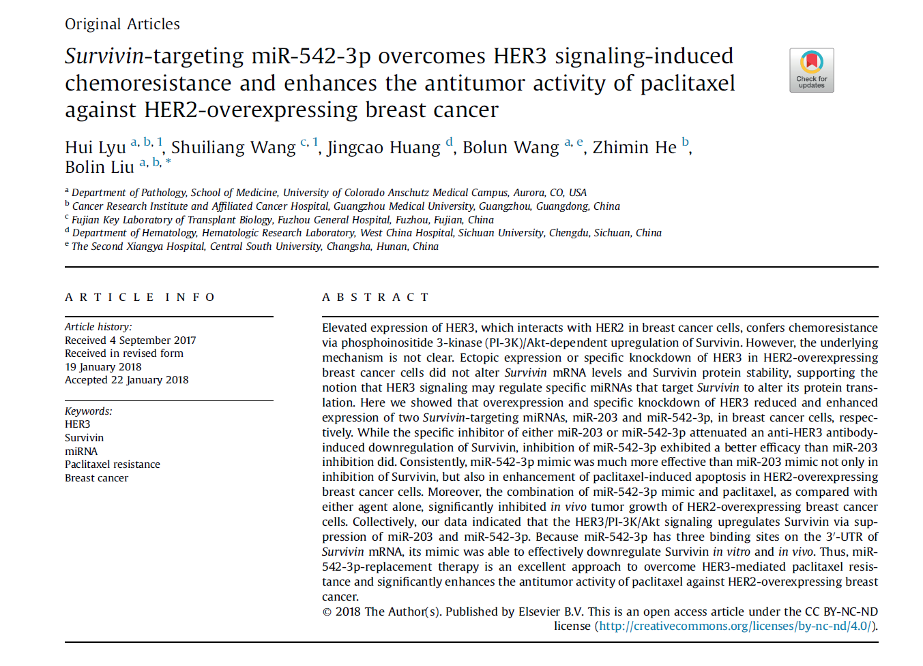

Slide 22
Data in biomedical sciences
Experiments require precise documentation
  Clinical trials use own data acquisition standards and tools
  Lab experiments increasingly publish not only papers but also datasets
  Primary source of scientific data peer-reviewed publications
  On-line available
    > 25 million abstracts via Pubmed / MEDLINE
    Millions of full texts

Slide 23
Biomedical databases
Typical questions
  Which genes / proteins in which organism are related to which biological processes
  Which structure and functions do they have?
  In which biochemical pathways are they related to which molecules?
  Which genetic defects are related to which diseases?
  Structured extracts of publications go into research databases, e.g. Uniprot, Ensembl, Reactome
    By the authors
    By database curators
By NLP-based algorithms

Slide 24
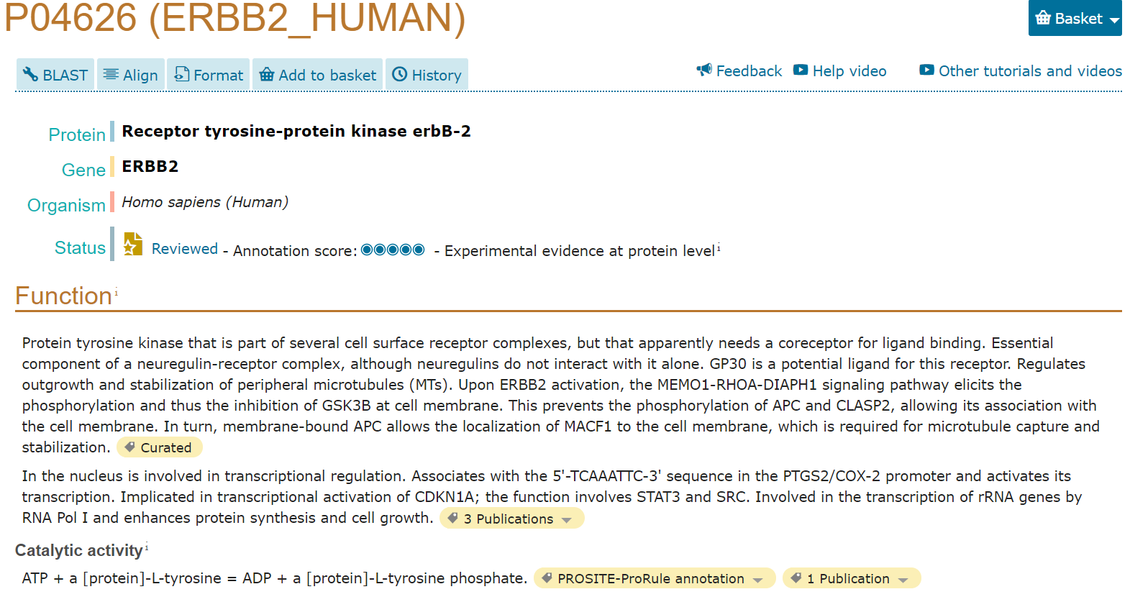
Uniprot: example record

Slide 25
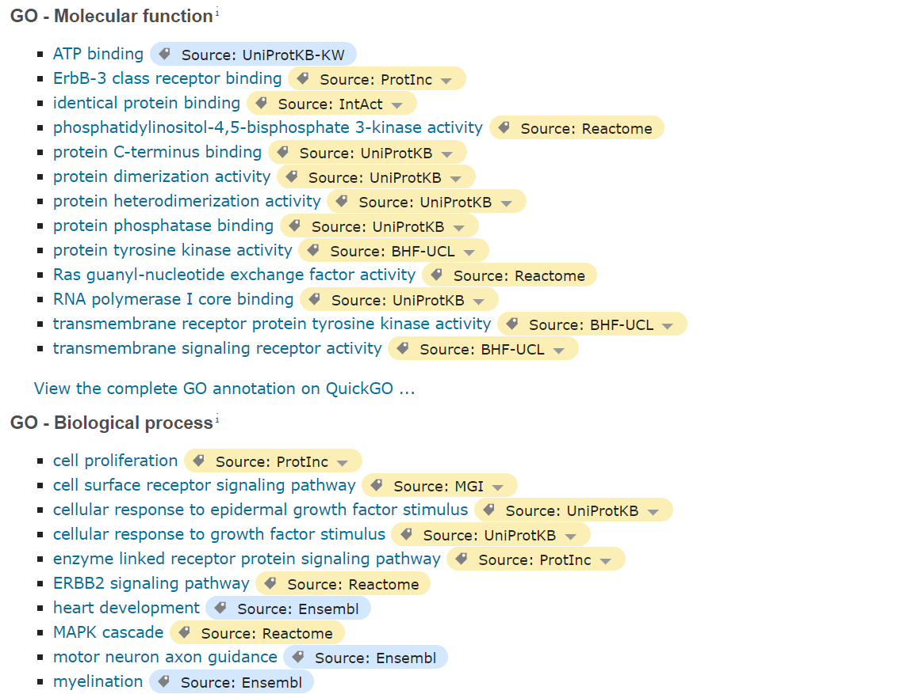
Uniprot: annotations with Gene Ontology
Explore biological
databases and identify where ontologies are used
Uniprot (proteins):
https://www.uniprot.org
Reactome (pathways)
https://reactome.org

Slide 26
Exercise (I)
Use the following upper-level categories:
Material entity, immaterial physical entity, quality, role, realizable (disposition, function), process, information entity, temporal region
Try to relate biomedical terms to these categories
Decide whether they denote subclasses or instances (individuals)
Discuss additional aspects like granularity and cardinality
Are there conflicting categorizations?

Slide 27
Exercise (II)
  Sample terms:
  “cranial cavity”, “aspirin”, “road traffic accident”, “liver function”, “headache”, “social security number”, “mouse embryo”, “blood”, “carbon atom“ , “red”, “persecutory delusion”, “Groote Schuur Hospital”, “nurse”, “American College of Rheumatology recommendations for the treatment of early rheumatoid arthritis”, “death”, “acute”, “tooth extraction”, “species homo sapiens”, “39.9°C”, “Ibuprofen 300 mg Capsule”, “admission diagnosis”, “tonsillectomy”, “World Health Organisation”, “malaria”, “gunshot injury”, “DNA”, “phenotype”, “Gene”, “colon cancer”, “life”, “insulin”, “hospital”, “white blood cell”, “body mass (in kg)”, “risk of breast cancer”, “patient”

Slide 28
Biomedical entities walkthrough
Ontological analysis:
  Inventory of middle level classes ?
  Categorization: upper level classes ?
  Properties: what do they have in common?
  Relations: how can they be related?

Slide 29
Material entities and immaterial spaces (I)
By increasing cardinality:
    Atoms, ions, small molecules, e.g. Calcium, Glucose
    Macromolecules, e.g. proteins, nucleic acids (RNA, DNA)
    Parts of macromolecules, e.g. gene sequences, protein sequences
    Molecule complexes, e.g. chromatin, chromosomes
    Cells, cell components and intracellular spaces, e.g. white blood cell, mitochondrion, cell nucleus, cell membrane, intracellular space.
    Anatomical entities: tissues, organ parts, organs, organ systems
    Organisms, unicellular (e.g. bacteria), multicellular
    Populations, cohorts

Slide 30
Material entities and immaterial spaces (II)
  Non-biological material entities of biomedical interest:
    Synthesised molecules (drugs)
    Lab devices
    Medical devices, implants
    Medical equipment, vehicles, buildings etc.
  Non-material physical entities
    Geographical region
    Habitat

Slide 31
Material entities and immaterial spaces (III)
  Other aspects
    Homomericity: part is of the same type: amount of water, amount of brain tissue etc.
    Single objects vs. collections of same object, e.g. aspirin molecule, vs. amounts of aspirin molecules - but distinct from aspirin tablet!
    Monomers vs. polymers: example carbohydrates, nucleic acids, proteins
Which relations are typical for this kind of entities ?

Slide 32
Processual entities (I)
At level below organisms
  At molecular level: modification, transport, signal transmission, regulation of activities, e.g. gene regulation, control of transcription
  At cellular level: mitosis, meiosis, cell death, propagation of impulses through nerves,…
  At tissue level: immune processes
  At level of organs and organ systems: motion, circulation, neuromuscular processes, digestion, respiration, wound healing , …

Slide 33
Processual entities (II)
With human agents on biological objects:
  laboratory processes, omics analyses
  Therapeutic interventions, diagnostic interventions, observing, interpreting, documenting, diagnosing, prescribing drugs, therapies
  Health system processes: admission, discharge, billing, reimbursement, training, certification ,…
  Lifestyle, physical exercise
Which relations are typical for processual entities ?

Slide 34
Realisables
Realisables exist even if not realised.
  Ability to interact on a molecular level
  Ability to perform cell division
  Ability to kill pathogens
  Ability to explode
  Disposition of a bone to break
  Reproductive function
  Function of pumping blood
  Walking function
  Risk of breast cancer
  Ability to lactate
Which relations are typical for realisables? How are they related to material objects, how to processes?

Slide 35
Roles
The role of a solvent
The role of a substrate in a chemical reaction
The role of a patient / of a health professional
Employer / employee
Parent, child, sibling,…
(Social) gender, ethnicity
The role of a predator / prey
Catalyst, enzyme
Roles in processes: active participant / passive participant / input / output
Food as a role of a certain amount of biological matter
Which relations are typical for roles?

Slide 36
Qualities
Physical qualities: weight, mass, electric charge, temperature
Qualities of processes, e.g. evolution of a disease process
Species quality, e.g. being a human, a fish, a mushroom
Canonicity, i.e. normal / abnormal, pathologic
Shapes
Which relations are typical for qualities entities ? How are they distinguished from realisables?

Slide 37
Information content entities
Epistemology vs. ontology
Image, e.g. X-ray
Plans
Thoughts, beliefs, opinions, cultural / individuals
Results of speech acts
Documents, i.e. results of documentation acts
Results of observations, measurements
Medical diagnosis, prognosis
Which relations are typical for information content entities ?

Slide 38
Social entities
    Associations, corporations, institutions, families
    E.g. hospital, school, lab, insurance company,
Which relations are typical for social entities ?

Slide 39
Entity types with multiple or debatable assignment to upper-level classes (I)
Diseases, disorders: What do a pneumonia, a club foot, a femur fracture, a seizure, an ulcer, a colon cancer have in common?
Related entities,
  E.g. genetic disposition -> manifestation
  e.g. cause / mechanism of an injury -> morphology -> process
Experiences, e.g. symptoms (individual perception of body dysfunction)?
Delusions?

Slide 40
Entity types with multiple or debatable assignment to upper-level classes (II)
What is the difference between the normal and the pathological?
E.g. alopecia, vitiligo, lifestyle preferences, uncommon behaviour, ageing?
Is this ontologically significant?
Socioeconomic conditions
Environment
System
Juridical “person”

Slide 41
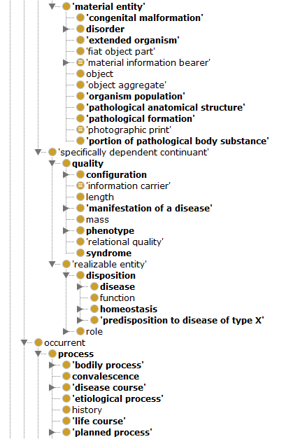
Example OGMS
Ontology for general medical science
https://bioportal.bioontology.org/ontologies/OGMS

Slide 42
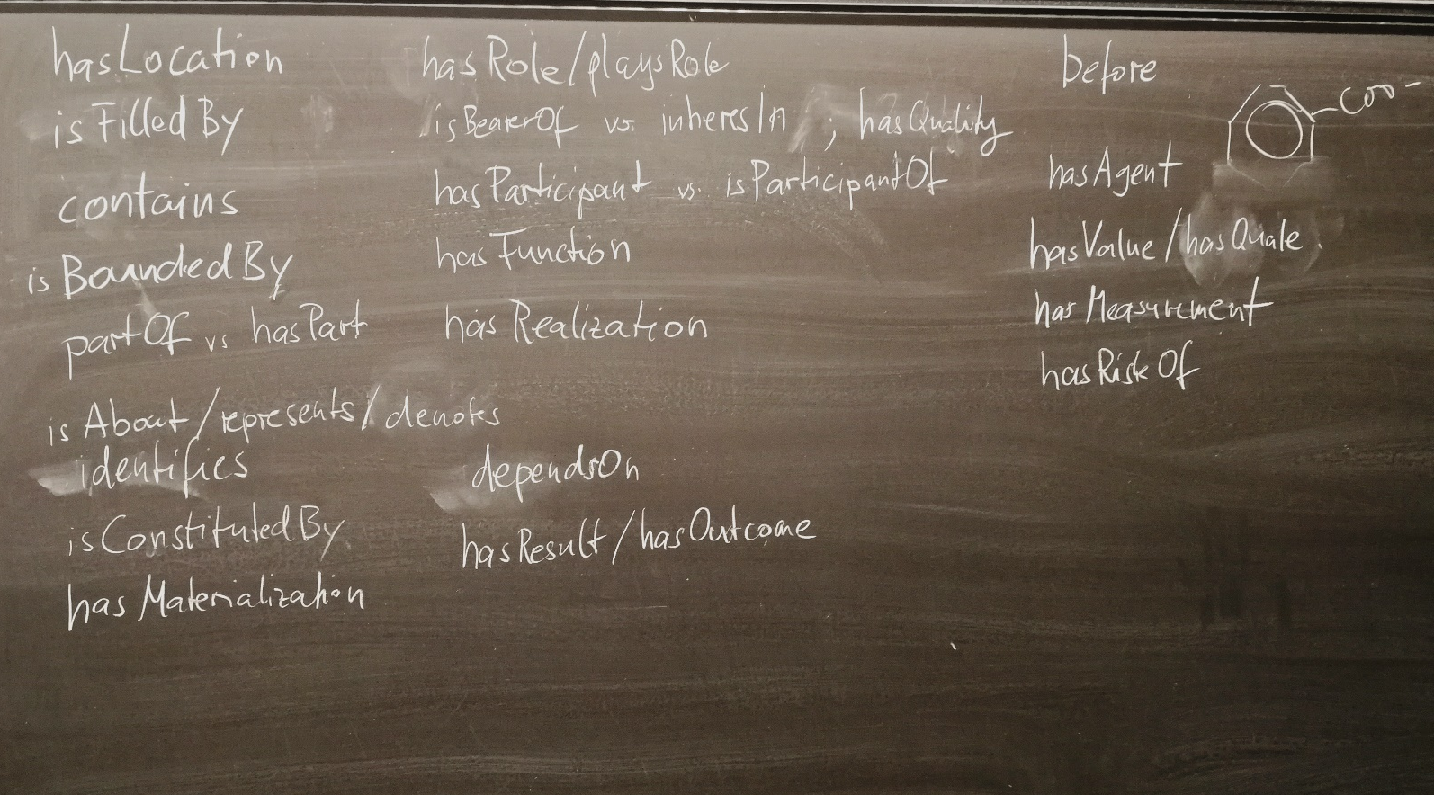
Ontological relations
As collected when discussing upper-level category assignment and exploring related entities
Roughly comparable with BioTop (next slide)

Slide 43
BioTop ontology
Domain-level foundational ontology for biology and medicine (BTL2 = BioTopLite v2)
OWL-DL
Strongly axiomatised
Mapped to BFO and RO
https://github.com/BioTopOntology/biotop
Talk in JOWO 2018
Schulz, S., Boeker, M., & Martinez-Costa, C. (2017). The BioTop family of upper level ontological resources for biomedicine. Stud Health Technol Inform, 235, 441-45.

Slide 44
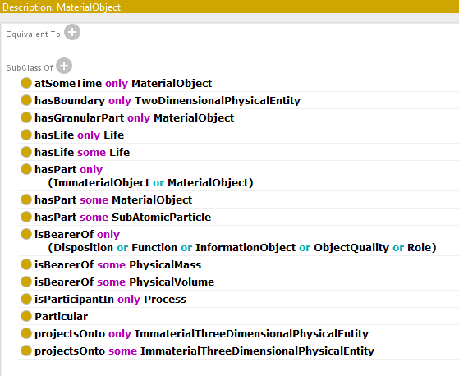
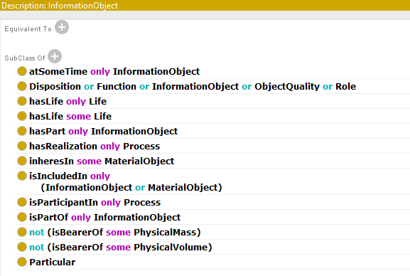
BTL2 Class Taxonomy BTL2 Relations BTL Axioms (examples)

Slide 45
Hierarchical knowledge organization systems in biology and medicine
ICD – International Classification of Diseases
MeSH – Medical Subject Headings
SNOMED CT
OBO Foundry Ontologies
  Gene Ontology
  Foundational Model of Anatomy (FMA)
  ChEBI – Chemical Entities of Biological Interest
Meta – terminologies / Catalogies
  UMLS – Unified Medical Language System
  Bioportal
Clinical Information Models

Slide 46
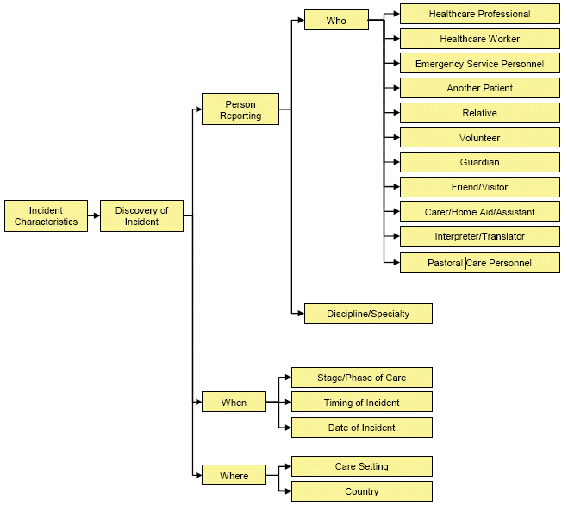
Not all hierarchies are ontological
Hierarchically structured
information template
no taxonomic relations
Schulz S, Karlsson D, Daniel C, Cools H, Lovis C.
Is the "International Classification for Patient Safety" a classification?
Stud Health Technol Inform. 2009;150:502-6.

Slide 47
ICD – International Classification of Diseases
A statistical classification of diseases, issued by WHO
Most recent release: ICD-11 for Mortality and Morbidity Statistics (2018)
Main building principles:
  Single, mostly taxonomic hierarchies
  Non-overlapping classes
Rules to assure this principle:
  E.g., Diabetes mellitus excludes Diabetes mellitus in pregnancy, which is in a different branch of the hierarchy
“Residuals” like “other”, “unspecified”
https://icd.who.int/browse11/l-m/en

Slide 48
MeSH – Medical Subject Headings
Thesaurus for Literature Indexing in Retrieval, issued by the U.S. National Library of Medicine
All MEDLINE literature records are manually annotated with MeSH concepts
Multi-hierarchical (overlap of tree-like hierarchies), spans all areas of medicine and biology
E.g. a paper indexed by “aspirin” and “stomach ulcer” would be found in a query with “antipyretics” and “gastrointestinal diseases”
https://www.ncbi.nlm.nih.gov/mesh/

Slide 49
SNOMED CT
Ontology-based terminology for representing content of the electronic health record
Run by an international standards organisation, requires licence for clinical use
Distributed in a tabular form, can be transformed into OWL – EL
Has its own OWL-like compositional syntax
Some semantic issues unresolved
http://browser.ihtsdotools.org/

Slide 50

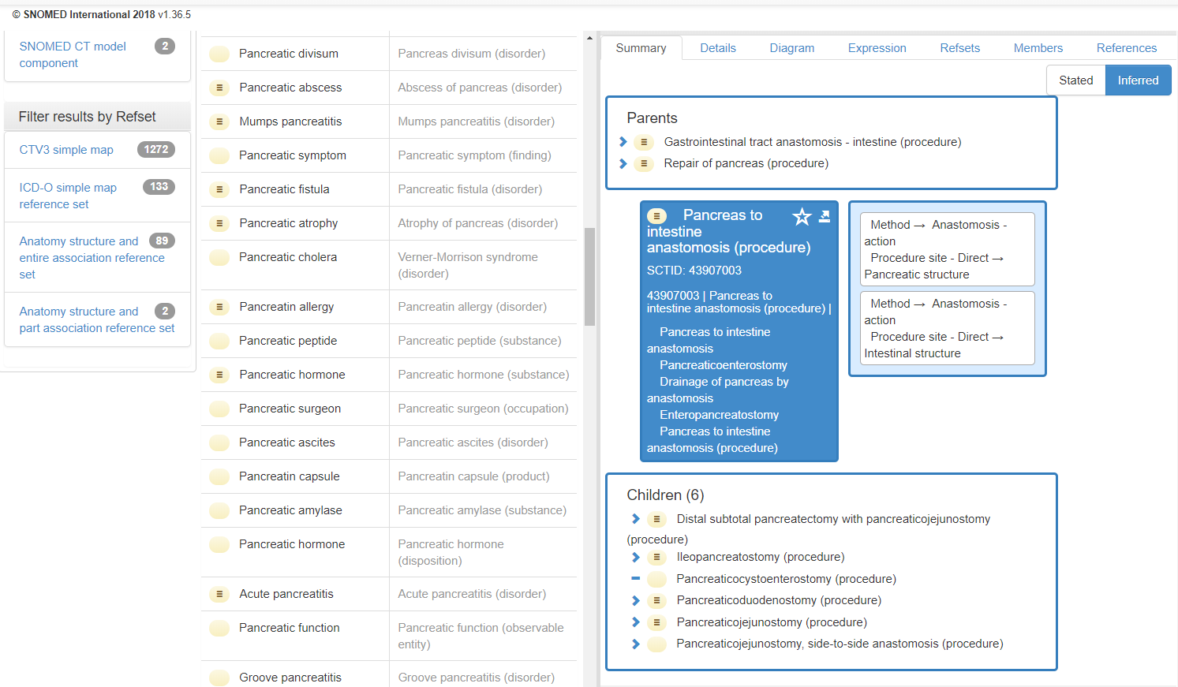
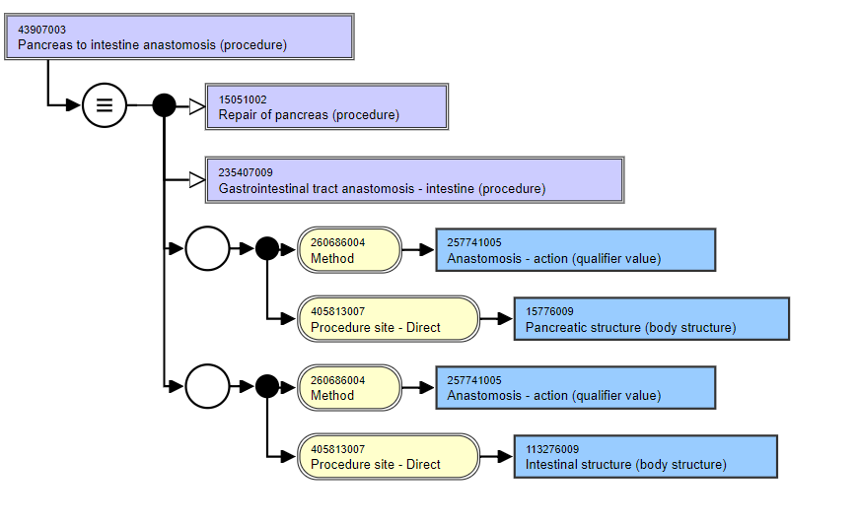
SNOMED CT: reference terminology
Ontological foundation

Slide 51
SNOMED CT – Structural benefits (I):
Polyhierachies
aggregated concepts for querying
Neoplasm
Substance
Disorder
B-cell
lymphoma
Non-Hodgkin
lymphoma
Low grade
B-cell lymphoma
Follicular
lymphoma
Monoclonal
antibody
Immuno-
suppressant
Viral
disease
Inflammatory
disorder
Follicular low grade
B-cell lymphoma
Herpes zoster
dermatitis
Rituximab
detailed patient-level encoding

Slide 52
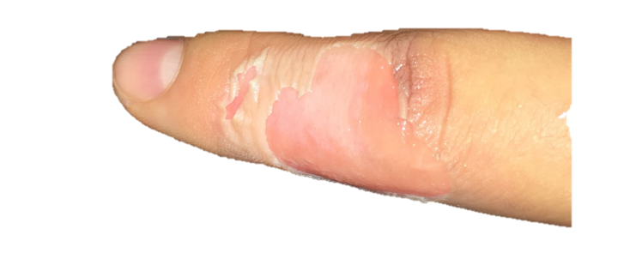
SNOMED CT – Structural benefits (II): Co-ordination
Pre-coordination
"Verbrennung 2. Grades eines einzelnen Fingers"
211908006 |Deep partial thickness burn of a single finger (disorder)|
≡
<<< 29673001 |Second degree burn of single finger, not thumb (disorder)| :
{ 116676008 |Associated morphology| = 262588000 |Deep partial thickness burn (morphologic abnormality)|,363698007 |Finding site| = 56213003 |Skin of finger (body structure)| }
Post-coordination
"Verbrennung 2. Grades der Rückseite des rechten Zeigefingers"
<<< 29673001 |Second degree burn of single finger, not thumb (disorder)| :
{ 116676008 |Associated morphology| = 262588000 |Deep partial thickness burn (morphologic abnormality)|,363698007 |Finding site| = 37314006 | Skin structure of dorsal surface of index finger (body structure) |, 272741003 |Laterality| = 24028007 |Right (qualifier value)| }

Slide 53

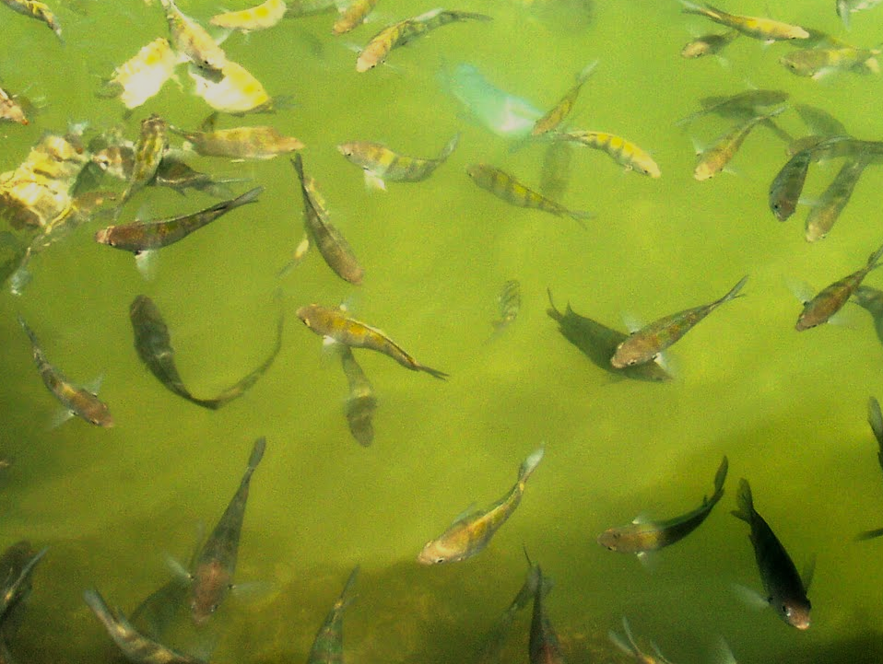
Interoperability ecosystem
  "Models of Use"
  Contextual embedding of terminologies
  "Models of Meaning"
  Describe characteristics of
  (classes of) domain entities
Information
Models
Reference
Terminologies

Slide 54
Interoperability ecosystem
Core
Reference
Terminology
Core reference terminology supplemented by and mapped with other reference terminologies.
Information
Models
Other
Reference
Terminologies

Slide 55
Interoperability ecosystem
AKA classification systems:
non-overlapping classes in single hierarchies, for data aggregation and ordering
AT₃
Core
Reference
Terminology
Information
Models
AT₂
AT₁
AT₄
Aggregation
Terminologies
(Classifications)

Slide 56
Interoperability ecosystem
SNOMED CT
Information
Models

Slide 57
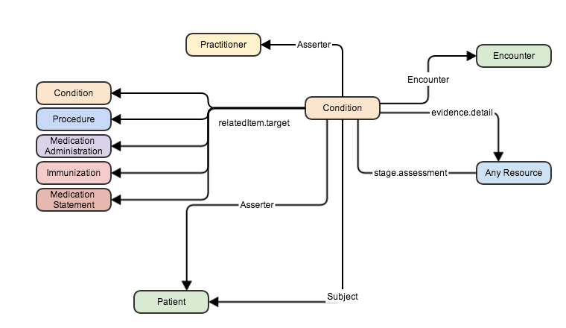

Information models
“models of use” vs. “models of meaning”
Recording templates for health care

Slide 58
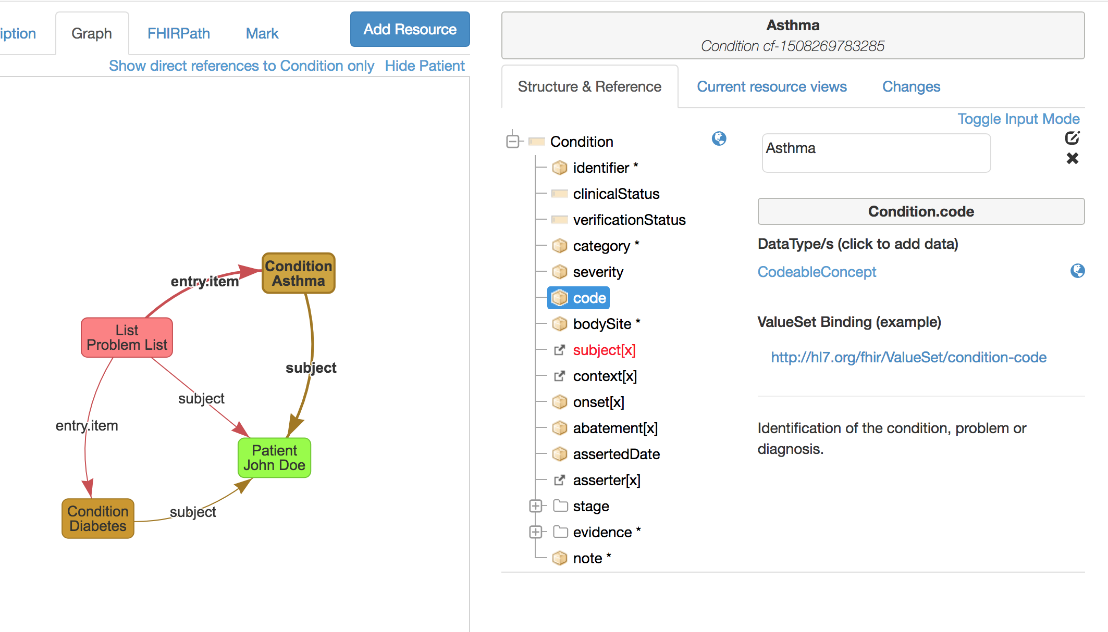
Example: “concept” in information models
Interface with ontology

Slide 59
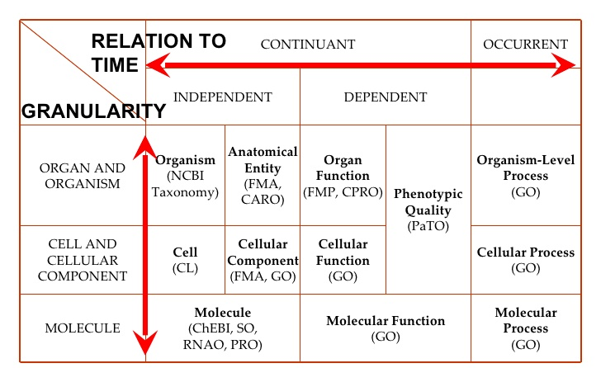
Open biomedical ontologies

Slide 60
Ontology Repositories
UMLS – Unified Medical Language System
https://uts.nlm.nih.gov/home.html
Bioportal
https://bioportal.bioontology.org/

