Slide 1



Building an experimental German user interface terminology linked to SNOMED CT
Stefan Schulz
Medical University
of Graz (Austria)
http://purl.org/steschu

Slide 2


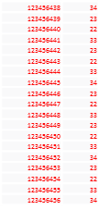






Context: Using SNOMED CT as annotation vocabulary for clinical narratives
Clinical data
prioritization /
visualization
Clinical and
administrative
decision support
Semantic
Biobank
Broker
Cohort
builder
KAGes Styria: > 1M patients
Staging
Area
Clinical Data
Warehouse
CDW
Medical
Research
Insights
(MRI)
Structured data
Lab, Admin,
QM, Registries
des Magens als auch des Duodenums reichlich zähflüssiger Schleim, sangoinolent; die Schleimhaut ist insgesamt livide. Anhängend ein 7,5 x 4 x 1,5 cm großes Pankreaskopfsegment sowie ein 4 cm langer derber und bis 2,5 cm durchmessender knotiger Gewebsstrang, der an seinem Ende eine Fadenmarkierung aufweist. Hier auf lamellierenden, teilweise nodulär
Semantic
Enrichment
Connected Health Platform
Unstructured
data (text)
Electronic Health
Record Systems
Text Mining
De-Identification
Ontologies
Terminologies
IICCAB: Innovative Nutzung von Informationen für klinische Versorgung und Biomarkerforschung. http://goo.gl/wHMedz
Notes:
ID Management
Forschungskontext
Behandlungskontext
Business Intelligence
Verwertung

Slide 3

Context: Using SNOMED CT as annotation vocabulary for clinical narratives
Clinical data
prioritization /
visualization
Clinical and
administrative
decision support
Semantic
Biobank
Broker
Cohort
builder
KAGes Styria: > 1M patients
Staging
Area
Clinical Data
Warehouse
CDW
Medical
Research
Insights
(MRI)
Structured data
Lab, Admin,
QM, Registries
des Magens als auch des Duodenums reichlich zähflüssiger Schleim, sangoinolent; die Schleimhaut ist insgesamt livide. Anhängend ein 7,5 x 4 x 1,5 cm großes Pankreaskopfsegment sowie ein 4 cm langer derber und bis 2,5 cm durchmessender knotiger Gewebsstrang, der an seinem Ende eine Fadenmarkierung aufweist. Hier auf lamellierenden, teilweise nodulär
Ontologies
Terminologies
Semantic
Enrichment
Connected Health Platform
Unstructured
data (text)
Electronic Health
Record Systems
Text Mining
De-Identification
IICCAB: Innovative Nutzung von Informationen für klinische Versorgung und Biomarkerforschung. http://goo.gl/wHMedz
Notes:
ID Management
Forschungskontext
Behandlungskontext
Business Intelligence
Verwertung

Slide 4
Using domain terminologies for NLP
I need to automatically annotate textual content
  which is in an idiosyncratic sublanguage
  which abounds of abbreviations and errors
  which uses highly ambiguous terms, only understandable in local contexts
  which is characterised by constantly new terms
Current situation:
  Numerous quasi-standard terminologies
  None of them cover all my concepts
  Many terms I use are not covered
  (although concepts are available)

Slide 5
Popularity of terms in PubMed
Preferred term (SNOMED CT) | Count |  | Synonym (SNOMED CT) | Count
Primary malignant neoplasm of lung | 0 |  | Lung cancer Bronchial carcinoma | 120682 3452
Cerebrovascular accident | 3819 |  | Stroke | 191559
Block dissection of cervical lymph nodes | 1 |  | Neck dissection | 7512
Electrocardiographic procedure | 1 |  | Electrocardiogram ECG | 33670 55120
Backache | 3489 |  | Back pain | 38132
Capillary blood specimens | 32 |  | Capillary blood samples | 574

Slide 6
Popularity of terms in medical records
Preferred term (ICD, OPS – German ) | Count |  | Synonym (German) | Count
Aortenklappenstenose | 3749 |  | Aortenstenose | 3126
Hirninfarkt | 7 |  | Schlaganfall | 65
Elektrokardiogramm | 0 |  | EKG | 12208
Koronare Herzerkrankung | 331 |  | KHK | 18455
Nicht-ST-Hebungsinfarkt | 498 |  | NSTEMI | 3839
Magnetresonanztomographie | 2 |  | NMR | 17

Slide 7

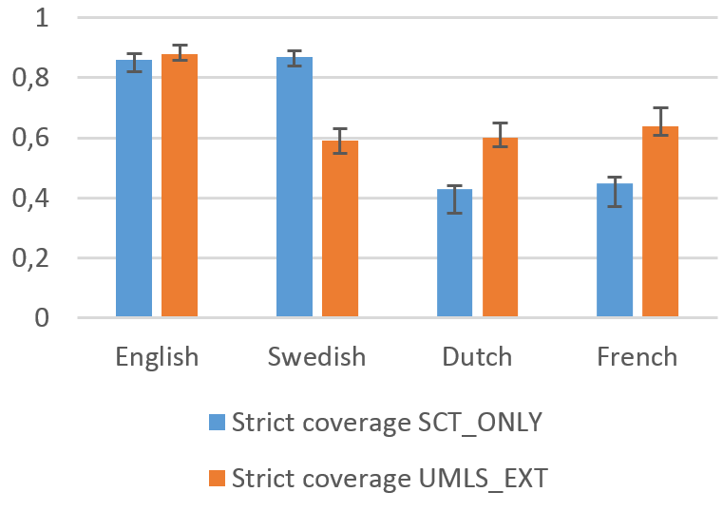
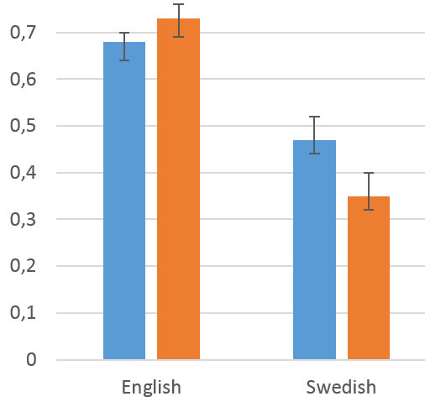
H2020: Assessing SNOMED CT for Large Scale eHealth Deployments in the EU
"Is SNOMED CT well suited as an
European reference terminology ?"
Manual annotation of a corpus of
clinical texts with SNOMED CT vs.
UMLS-Extract
Assessment:
  concept coverage
  term coverage
Differences SNOMED CT
Swedish – English
  Swedish:
  one term per concept
  English:
  on average 2.3 terms
  per concept (Preferred terms , synonyms)
Concept coverage
Term coverage

Slide 8
Two Aspects of Terminologies
Normative
  Codes + Labels (names) denote well-defined entities in a realm of discourse
  "Explanatory“ labels e.g.
  "Primary malignant neoplasm of lung (disorder)".
  Scope notes definitions
  (formal definitions → ontology)
Descriptive
  Describes human language expressions as being used
  "Lung cancer"
Reference
Terms
Interface
Terms
Many domain terminologies / ontologies contain interface terms,
but far from being exhaustive

Slide 9
Separation
Reference Terminologies
Ontologies
Interface
Terminology A
Interface
Terminology B
Interface
Terminology C
ASSESS CT Recommendations:
http://assess-ct.eu/fileadmin/assess_ct/final_brochure/assessct_final_brochure.pdf

Slide 10
Case study: German interface terminology for SNOMED CT
Context: CBmed IICCAB* (see poster)
Limited resources, incremental approach
Top-down:
  Modularization of original terms (split into ngrams):
    "Magnetic resonance imaging of neck with contrast"
  Translating / finding synonyms of derived, highly repetitive phrases:
    "Magnetic resonance imaging" in 627 SNOMED terms
    "Second degree burn" in 166 SNOMED terms
  Acquisition of translations and synonyms by decreasing frequency (machine translation, automated synonym acquisition)
  Manual revision
Bottom-up:
  Collection of popular interface terms from n-gram frequency lists extracted for clinical corpora
*Schulz S. Innovative Nutzung von Informationen für klinische Versorgung und Biomarkerforschung. http://goo.gl/wHMedz

Slide 11
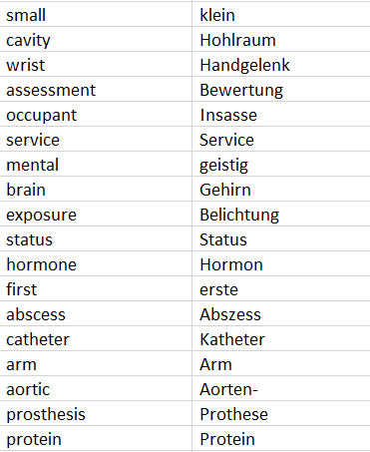
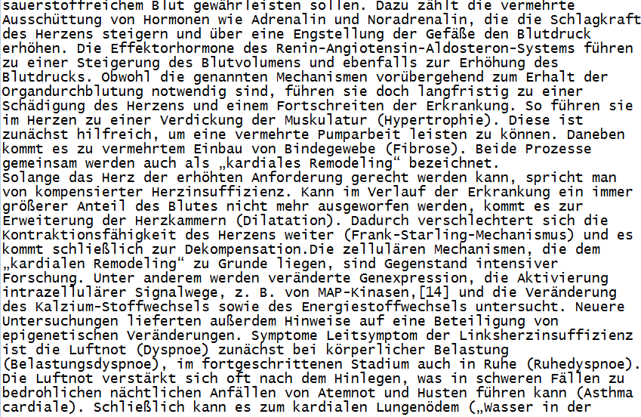
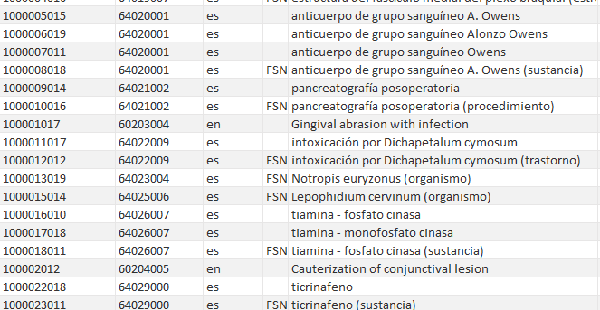
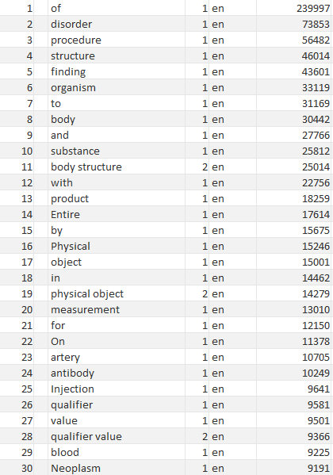

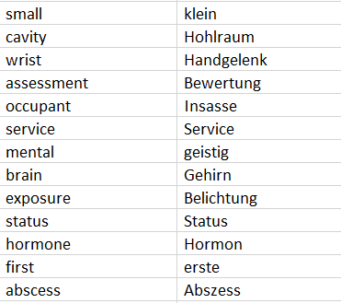
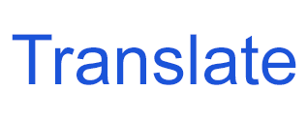
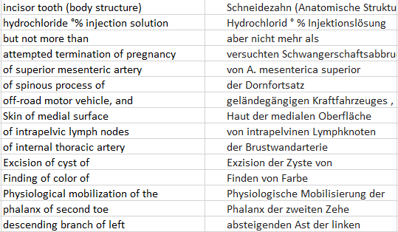
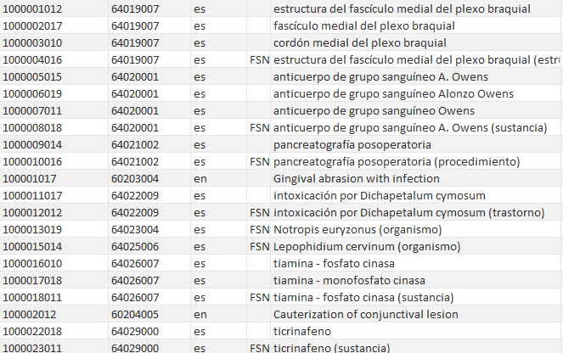
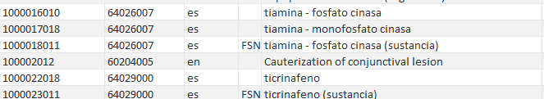
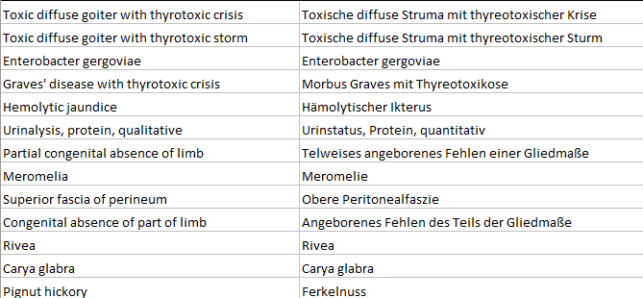
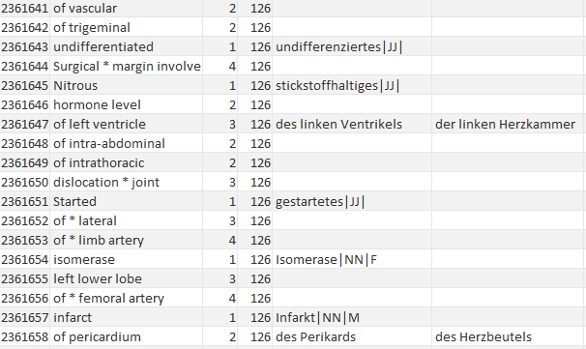
Case study: German interface terminology for SNOMED CT
Char
Rules
Token
translation
Rules
trans
-
rule
lations
acquisition
Reference
Clinical
corpus (DE)
corpus (DE)
Chunker
rule
untranslated
exec
New
Translatable SCT
tokens
Token
descriptions (EN)
trans
-
lations
n
-
grams (EN)
POS
filter concepts with
tags
identical terms
across translations
n
-
gram
Human curation
translations
•
correct
most
frequent
mis
-
n
-
grams (DE)
translations
Non
-
Translatable
Phrase
•
remove wrong
SCT descriptions
generation
translations
All SCT descriptions (EN)
rules
•
check POS tags
•
normalise
adjectives
•
add synonyms
Term
reassembling
heuristics
Raw full terms
Human Validation
Curated
ngram
(DE)
translations(DE)
•
dependent on use cases
•
e.g. input for official
translation
•
e.g. starting point for
crowdsourcing process for
interface term
generation
•
lexicon for NLP
approaches

Slide 12
Case study: German interface terminology for SNOMED CT
Core vocabulary:
  Constantly checked and enhanced by domain experts (medical students)
  Priorisation by use cases
Guidelines
  Avoidance of ambiguous entries: preference of composed terms
  (e.g. "delivery" → "drug delivery", "preterm delivery")
  Acronyms only in context: not "CT" but "CT guided"
  Inflection, compositions rules requires special markers (German) and rules for reassembly of terms
Current state:
  ca. 2 Million Interface-Terms
  Automatically generated from core vocabulary with 92,500 German
  n-grams, out of 85,400 English n-grams
  Benchmark: parallel corpus extracted from Medline:
  current term coverage 33.1% for German vs. 55.4% for English

Slide 13
Core n-gram vocabulary

Slide 14
Automatically generated interface terminology

Slide 15
Scaling up…
Taming size:
Crowdsourcing for terminology development
Taming ambiguity:
Document preprocessing using language models

Slide 16
Crowdsourcing for terminology development
Functionality: entry of new terms, commenting and validating existing terms
Possible central data element :
Interface Term – External Code
"DM" - 81827009 |Diameter (qualifier value)
Possible Attributes:
  Creator, creation type, date, (sub)domain, user group
  Max Muster, manual, 20170803, Dermatology Graz, Doctor
  Example annotation, e.g.
  "ein 3 cm im DM haltender Tumor"
  Validation/ commenting by other users
  John Doe, 20180912, 
  "Example incomprehensible – additional examples needed"

Slide 17
Short forms – Document preprocessing
Ambiguous short forms not in dictionary
Difficulty of maintenance
  Abundance of concurring readings
  High productivity
Instead:
  Main assumption: short forms and expansions occur in the same corpus
  Automatically create N-gram model from specific reference corpus
  Replace short forms by most plausible expansions
  The same for other out of-lexicon words, e.g. misspellings
  If assumption fails: try Web mining

Slide 18

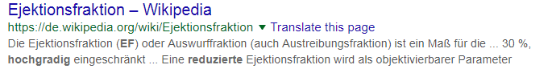
Example: Resolution of short forms
"dilat. Kardiomyopathie, hochgr. red. EF"
Word-n-gram model (30,000 discharge summaries)
Web mining
1035 dilat. Kardiomyopathie
1442 dilatative Kardiomyopathie
7 hochgr. red. EF
4 hochgradig reduzierte EF

Slide 19
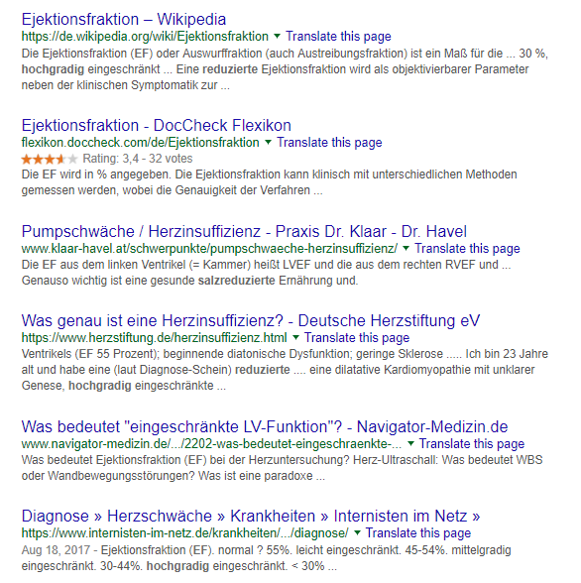
Example: Resolution of short forms
Interpretation:
  Salience
  Acronym-definition
  patterns
  Regular expressions
  created from short
  forms
Accuracy of method currently studied

Slide 20
Recommendations
Need for interface terms not satisfied by domain terminologies
Dynamic acquisition of interface terms needed
  Top-down (from reference terminologies)
  Bottom up (from corpora)
Use collaborative approach (crowdsourcing)
Avoid ambiguous terms in lexicon
Use n-gram models (alternatively deep learning ?) for out-of-lexicon terms, extracted from related corpora
  Benefitting from typical local contexts in "similar" documents
    Resolution of short forms
    Correction of typos

