Slide 1
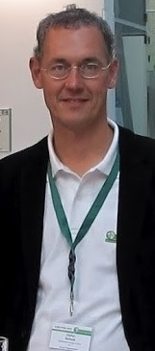
Knowledge acquisition and management for clinical decision-making
Department of Biomedical Informatics, University at Buffalo
Grand Rounds September 9th, 2016
Stefan Schulz
Medical University of Graz (Austria)
stefan.schulz@medunigraz.at

Slide 2
Topics of the talk
Context: representation of knowledge in computer science
What are the types of knowledge to be distinguished
How are they connected
How can data help acquire and maintain knowledge?
Notes:
hacer una distinida

Slide 3
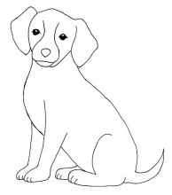

Knowledge map
Universals
Symbols
Individuals
denotation
instantiation
"perro", "dog"
"canino",
"canis", "dog"
"Marley"
"Marley"
denotation
C. K. Ogden and I. A. Richards (1923) The Meaning of Meaning
Notes:
el ladrido del perro

Slide 4
Knowledge map
Universals
Symbols
Individuals
dogs are
possible
vectors of
rabies
dogs
are
vertebrates
❺
❻
"canis familiaris"
and "dog"
are
synonyms
Marley is a
dog
❹
denotation
instantiation
❷
"dog" is a
noun
Marley lives
in Florida
❸
denotation
❶

Slide 5
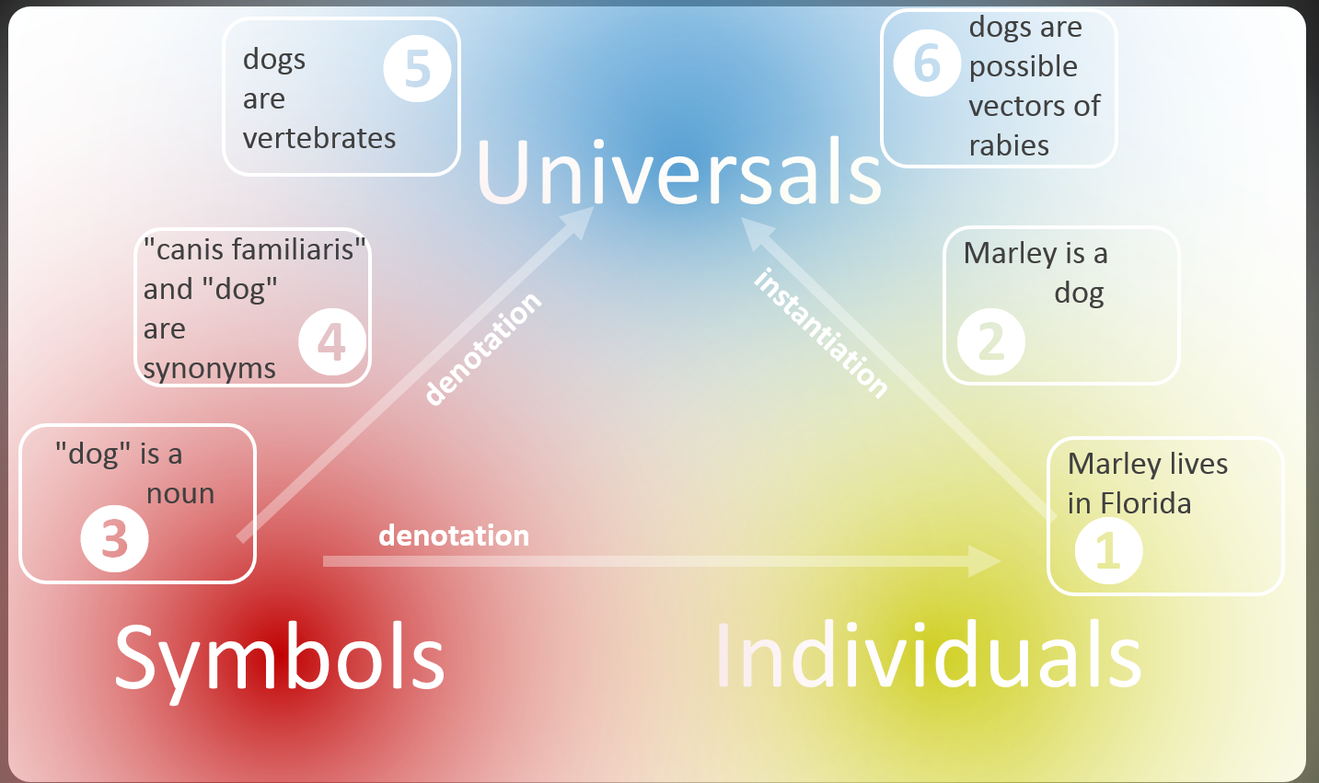
Ontological knowledge:
Axioms that are universally true
Contingent knowledge:
typical, likely, possible
Linguistic knowledge:
Statements about properties and
meaning of signs of language
Factual knowledge:
Statements about concrete entities
and their relationships

Slide 6
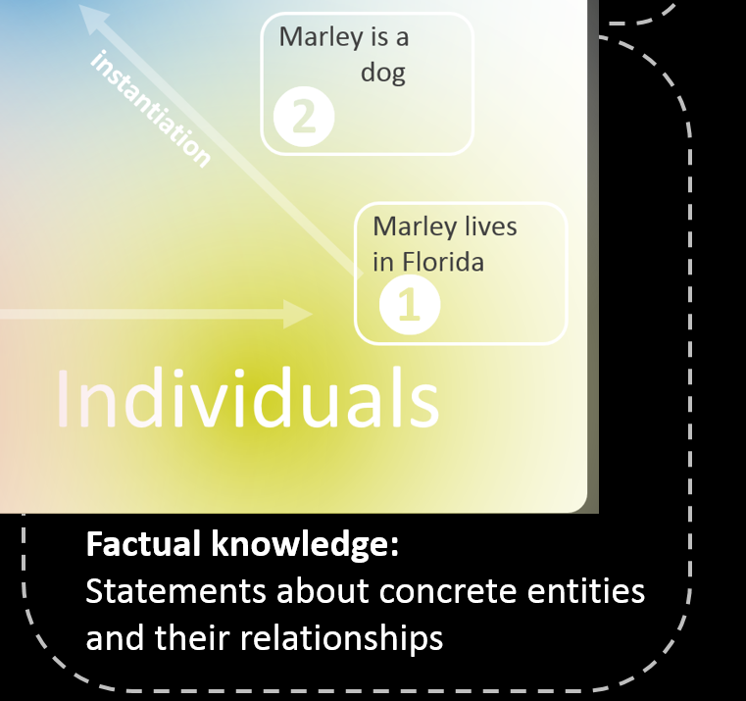

Slide 7
Statements about individuals
<Subject> <Predicate> <Object>
:Florida rdf:type :state
:Marley rdf:type :dog
:Marley :lives :Florida
Syntax TURTLE : https://www.w3.org/TR/turtle/

Slide 8
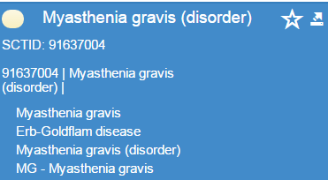
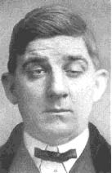
Information extraction
Physical examination on admission revealed purpura of the upper and lower extremities, swelling of the gums and tonsils, but no symptoms showing the complication of myasthenia gravis. Hematological tests revealed leucocytosis: WBC count 68 700/µl (blasts 11.5%, myelocytes 0.5%, bands 2.0%, segments 16.0%, monocytes 65.5%, lymphocytes 4.0%, atypical lymphocytes 0.5%), Hb 7.1 g/dl (reticulocytes 12%) and a platelet count of 9.1 × 104/µl. A bone marrow aspiration revealed hypercelllar bone marrow with a decreased number of erythroblasts and megakaryocytes and an increased number of monoblasts
ADM{419620001
110714004
65124004 113279002
NEG{116223007 91637004 252275004
111583006} 767002[68700] 271040006[11.5]
313696224[0.5] 313696667[2.0]
313696009[16.0] 271037006[65.5]
271036002[4.0] 271036013[0.5]
365809007[7.1] 45995003[12]
365632008[91000] }
49401003 76197007 14016003
420510009 103213002
53945006 35105006
Instantiation
rdf:type
http://www.beverlyhillsneurology.com/myastheniagravis-symptoms.html
Schulz S, Daumke P, Stenzhorn H, Markó K, Poprat M: Incremental Semantic Enrichment of Narrative Content in Electronic Health Records. World Congress on Medical Physics and Biomedical Engineering, 2009

Slide 9
Ontological knowledge:
Axioms that are universally true
Contingent knowledge:
typical, likely, possible
Linguistic knowledge:
Statements about properties and
meaning of signs of language
Factual knowledge:
Statements about concrete entities
and their relationships

Slide 10
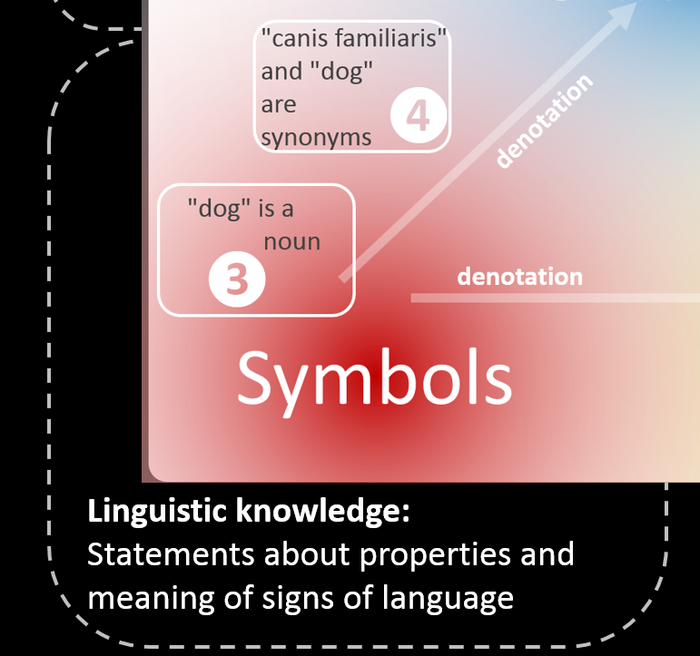

Slide 11
Representations SKOS / Linked Data
:ex:Dog rdf:type skos:Concept
:ex:Dog skos:prefLabel "dog"@en;
:ex:Dog skos:prefLabel "perro"@es;
:ex:Animal rdf:type skos:Concept
:ex:Animal skos:broader ex:Dog
wr:dog lemon:sense wr:dog-English-Noun-1
wr:dog lemon:sense wr:dog-English-Verb-1
wr:dog-English-Noun-1 wt:hasPoS wt:Noun
Syntax TURTLE : https://www.w3.org/TR/turtle/
Wiktionary: http://wiki.dbpedia.org/wiktionary-rdf-extraction

Slide 12
❸ Linguistic knowledge:
POS tagging
"Myasthenia" is a noun"
JJ Physical NN examination IN on NN admission VBD revealed NN purpura IN of DT the JJ upper CC and JJR lower NNS extremities , , VBG swelling IN of DT the NN gums CC and NNS tonsils , , CC but DT no NNS symptoms VBG showing DT the NN complication IN of NN myasthenia NN gravis . . JJ Hematological NNS tests VBD revealed NN leucocytosis : : NNP WBC VBP count CD 68 CD 700 NN / NN µ NN l -LRB- ( NNS blasts CD 11.5 NN % , , VBZ myelocytes CD 0.5 NN % , , NNS bands CD 2.0 NN % , , NNS segments CD 16.0 NN % , , VBZ monocytes CD 65.5 NN % , , VBZ lymphocytes CD 4.0 NN % , , NN atypical VBZ lymphocytes CD 0.5 NN % -RRB- ) , , NNP Hb CD 7.1 NN g NN / NN dl -LRB- ( VBZ reticulocytes CD 12 NN % -RRB- ) CC and DT a NN platelet NN count IN of CD 9.1 NN × CD 104 NN / NN µ NN l . . DT A NN bone NN marrow NN aspiration VBD revealed JJ hypercelllar NN bone NN marrow IN with DT a VBN decreased NN number IN of NNS erythroblasts CC and NNS megakaryocytes CC and DT an VBN increased NN number IN of NNS monoblasts
http://cogcomp.cs.illinois.edu/

Slide 13
❹ Linguistic knowledge:
Expansion of short forms
pattern to extract acronym definitions from a corpus
Pattern | Example
Acronym (Definition) | CVA (Cerebrovascular accident)
Definition (Acronym) | Cerebrovascular accident (CVA)
Acronym – Definition | CVA – Cerebrovascular accident–
Definition – Acronym | Cerebrovascular accident–ACV–
C < V < A
Sánchez D. & Isern D. Automatic extraction of acronym definitions from the Web. Appl Intell (2011) 34: 311–327

Slide 14
Ontological knowledge:
Axioms that are universally true
Contingent knowledge:
typical, likely, possible
Linguistic knowledge:
Statements about properties and
meaning of signs of language
Factual knowledge:
Statements about concrete entities
and their relationships

Slide 15
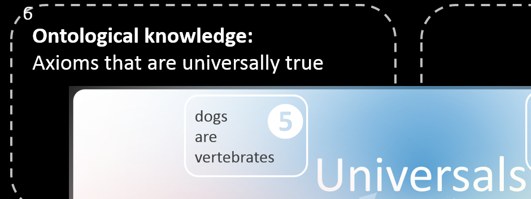

Slide 16
Representation OWL
Dog subclassOf Vertebrate
Vertebrate subclassOf Animal
Vertebra subclassOf Bone
Vertebrate equivalentTo Animal and
has-part some Bone
computable inference
(e.g. HermiT or Fact++
OWL reasoner)
There is no dog that has no bones
OWL Manchester Syntax: https://www.w3.org/TR/owl2-manchester-syntax/
HermiT reasoner: http://www.hermit-reasoner.com/
Fact++ reasoner: http://owl.man.ac.uk/factplusplus/

Slide 17
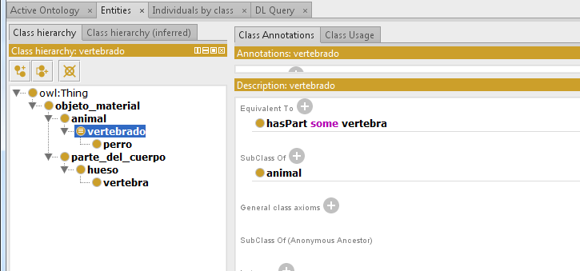

Slide 18
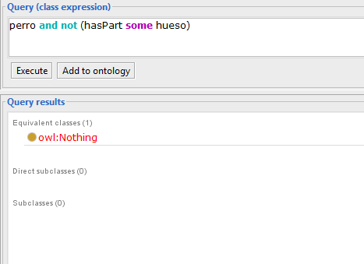

Slide 19
Extraction of taxonomic relations
Lexical-semantic patterns Hearst:
Patrón | Ejemplo
NP such as {NP}* (and|or) NP | "AGE-binding proteins, such as GAL-3"
NP {NP}* (and|or) other NP | "fractures or other Injuries"
NP including {NP}* (or|and) NP | "mental illnesses including schizophrenia"
AGE-binding protein
injury
mental illness
subclass-of
subclass-of
subclass-of
GAL-1
fracture
schizophrenia
Marti A. Hearst. Automatic acquisition of hyponyms from large text corpora. In Proceedings of the Fourteenth International Conference on Computational Linguistics, pages 539--545, Nantes, France, July 1992.

Slide 20
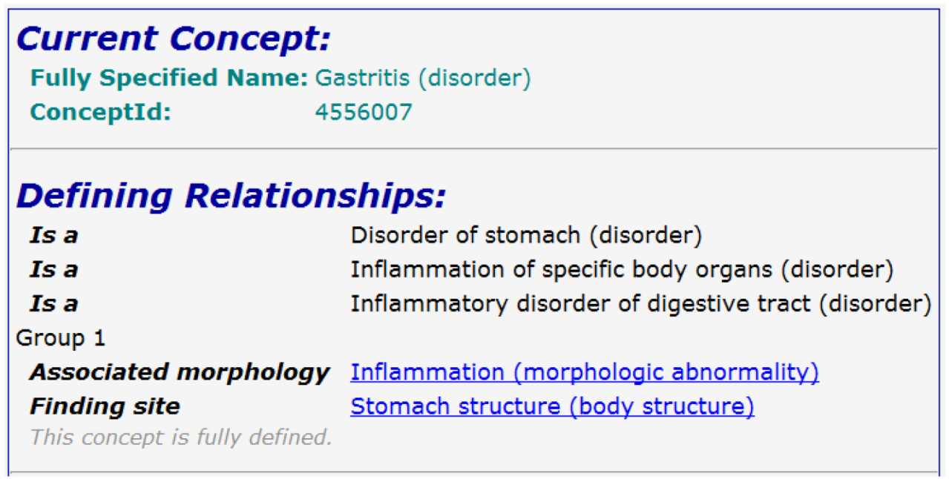
❺ Extracción de otras relaciones
Validation of SNOMED
CT axioms by Web
mining
Query:
"Gastritis is an
inflammation of"
Result | Frequency
"stomach lining" | 44
"lining of the stomach" | 22
"lining of your stomach" | 3
"lining of stomach" | 1
Kreuzthaler M, Schulz S. Metonymies in medical terminologies. A SNOMED CT case study. AMIA Annu Symp Proc. 2012;2012:463-46.

Slide 21
Ontological knowledge:
Axioms that are universally true
Contingent knowledge:
typical, likely, possible
Linguistic knowledge:
Statements about properties and
meaning of signs of language
Factual knowledge:
Statements about concrete entities
and their relationships

Slide 22
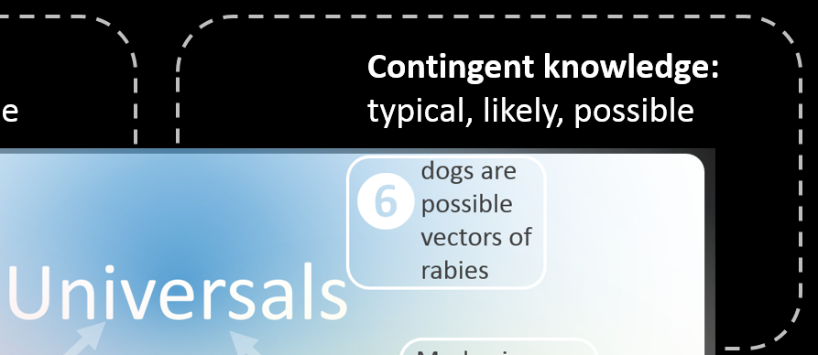

Slide 23
Contingent knowledge
Alan Rector (2008):
" very few interesting items of knowledge that are truly ontological…". Much current work on informatics ontologies is aimed at integrating probabilistic and typical reasoning with universal “ontological” reasoning effectively. Hence, the background information for a clinical system often goes well beyond the ontology, in this strict sense. Brachman introduced the notion of the ontology as a “conceptual coat rack” on which other information is held."
Rector A (2008): Semantichealth Deliverable 6.1

Slide 24
Don't do this !
Dog subclassOf
vector-of some Rabies
Tobacco subclassOf
causes some Cancer
Aspirin subclassOf
treats some Pain
Rabies subclassOf
has-vector some Dog
Cancer subclassOf
caused-by some Tobacco
Pain subclassOf
treated-by some Aspirin

Slide 25
Triple representation
No formal semantics!
Different, mostly complex interpretations
<Subject> <Predicate> <Object>
:Dog :vector-of :Rabies
:Tobacco :causes :Cancer
:Aspirin :treats :Pain
:Fever :suggests :Malaria
:Bird :capable-of :Flying

Slide 26
❻ Example: extraction of contingent
(non ontological knowledge) from MEDLINE
Co-occurrence analysis
Qualifies source concept, e.g:
DT = "drug therapy"
PC = "prevention and control"
CO = "complication"
Notes:
ambiguo

Slide 27
Predicate extractions according to MeSH subheadings analysis
Object
Subject
Simplified: high frequency of " TU" ("therapeutic use") suggests the predicate "treats", high frequency of "PC" (prevention & control ) suggests "prevents"
Miñarro-Giménez JA, Kreuzthaler M, Schulz S. Knowledge Extraction from MEDLINE by Combining Clustering with Natural Language Processing. AMIA Annu Symp Proc. 2015 Nov 5;2015:915-24. eCollection 2015

Slide 28
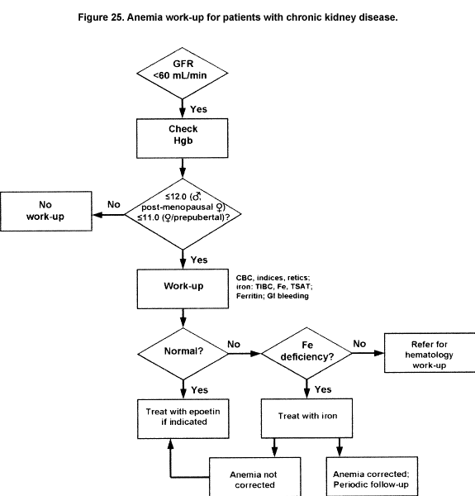
Clinical practice guidelines

Slide 29
6
Ontological knowledge:
Axioms that are universally true
Contingent knowledge:
typical, likely, possible
Linguistic knowledge:
Statements about properties and
meaning of signs of language
Factual knowledge:
Statements about concrete entities
and their relationships

Slide 30
6
Ontological knowledge:
Axioms that are universally true
Contingent knowledge:
typical, likely, possible
SUSTAINABLE
KNOWLEDGE
DYNAMIC
KNOWLEDGE
Linguistic knowledge:
Statements about properties and
meaning of signs of language
Factual knowledge:
Statements about concrete entities
and their relationships

Slide 31






Knowledge assets, users and information systems
4
Ontologies
provide
meaning
Knowledge bases
Fact stores
Formal
Ontologies
(models of generalized reality)
Rule bases
(clinical guidelines)
use
use
use
denote
Information system
Repositories of human language
expressions and formalisms
use
use
denote
Individuals
Notes:
el ladrido del perro

Slide 32
Perspectives
Use big data to help construct and maintain large knowledge resources
Importance of unstructured data in clinical data management
  Used for knowledge construction
  Used as input for decision-making
Sensitize knowledge engineers to distinguish between qualitatively different knowledge assets
Distinction between sustainable and permanent knowledge assets

Slide 33
Questions?
stefan.schulz@medunigraz.at

