Slide 1
Higgs bosons, mars missions, and unicorn delusions: How to deal with terms of dubious reference in scientific ontologies
International Conference on Biomedical Ontology
University at Buffalo, NY · July 26-30, 2011
Stefan Schulz^{a,b}
Mathias Brochhausen^{c}
Robert Hoehndorf^{d}
ªInstitute for Medical Informatics, Statistics and Documentation, Medical University, Graz, Austria
^{b}Institute of Medical Biometry and Medical Informatics, University Medical Center Freiburg, Germany
^{c}Division of Biomedical Informatics University of Arkansas
^{d}Department of Genetics, University of Cambridge, UK

Slide 2
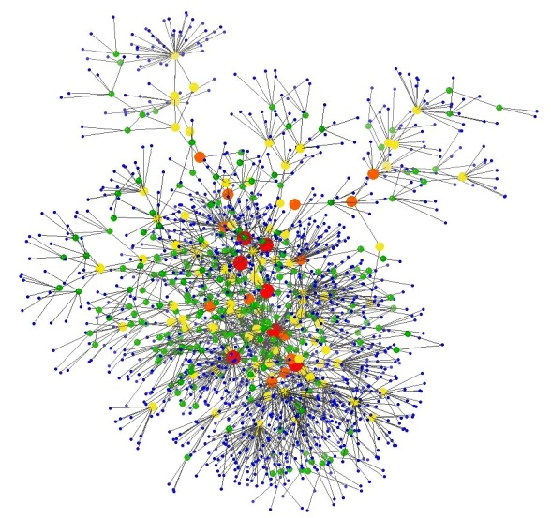
There are different views on the content of scientific ontologies
Aristotelian Realist:
Ontologies represent universals
Universals exist in their instances
Universals extend to classes
No universals extend to empty classes
OBO Foundry: Defined classes are allowed given they are not empty
User:
Ontologies provide semantic identifiers (and their meaning) to annotate scientific discourse
Ontologies may support knowledge management through automated reasoning
Logician:
Ontologies are sets of axioms containing class and relation symbols and logic constructors
New classes can be created as long as the obey the syntax, e.g. A equivalentTo B and C D equivalent to (not A)

Slide 3
Scientific discourse may contain terms of dubious reference.

Slide 4
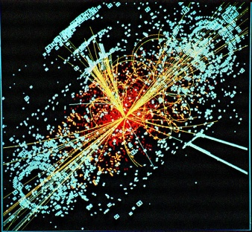
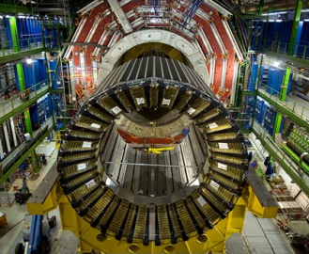
Hypothetical entities and unrealized plans can be defined in terms of logic.
Higgs Boson: hypothetical elementary particle,
so far not found by
experiment:
Large Hadron Collider (CERN) 3 000 000 000 €
Manned Mars Mission: science fiction but also subject of scientific proposals:
e.g. NASA Design Reference Mission 3.0
HiggsBoson EquivalentTo ScalarBoson and NeutralParticle and …
MannedMarsMission EquivalentTo
MarsMission and
hasParticipant some Human
ScalarBoson
NeutralParticle
MarsMission
hasParticipant some Human
not known whether empty
empty in 2011 empty in 2031 ?

Slide 5
Fictitious terms can be defined by logic, too.
Unicorn EquivalentTo
Horse and
hasPart some Horn
Horse
Things with Horn
always empty

Slide 6
Fictitious terms are used as metaphors or themes of delusions.
Unicorn Delusion EquivalentTo
Delusion and isAbout only Unicorn

Slide 7
Fictitious terms are used as metaphors or themes of delusions.
Exist
Do not Exist
isAbout
Unicorn Delusion
Unicorn
subClassOf
subClassOf
isAbout
Pink Unicorn Delusion
Pink Unicorn

Slide 8
Fictitious terms are used as metaphors or themes of delusions.
Exist
Does not Exist
isAbout
Irrelevant for Realist Ontologies
Unicorn Delusion
Unicorn
subClassOf
subClassOf
isAbout
Pink Unicorn Delusion
Pink Unicorn

Slide 9
Classes that refer to fictitious terms can be fully defined referring to universals only
Examples:
Higgs Boson Research Project
Manned Mars Mission Plan
Unicorn delusion
Running example: Unicorn delusion
Unicorn Delusion EquivalentTo
Delusion and isAbout only Unicorn
PinkUnicorn Delusion EquivalentTo
Delusion and isAbout only PinkUnicorn
inferred subclass relation
Unicorn Delusion EquivalentTo
Delusion and isAbout only (Horse and hasPart
some Horn)
PinkUnicorn Delusion EquivalentTo
Delusion and isAbout only
(Horse and (hasPart some Horn)
and (bearerOf some Pink))

Slide 10
There are two ways to deal with non-referring terms in ontologies
To include them indirectly in full definitions that do not contradict the realist paradigm: Disadvantage: ontology provides no identifiers for e.g. Higgs boson or Manned mars mission, users need to coordinate.
Include them into OWL models as explicit non-ontological extensions of ontologies - for convenience. (OWL model ≠ realist ontologies)

Slide 11
Inclusion of a branch "Terminological Unit" in an ontology

Slide 12
Inclusion of a branch "Terminological Unit" in an ontology
Upper ontology and domain classes
Terminological Units (including universals) are expressed as particulars
Classification of Terminological Units

Slide 13
Inclusion of a branch "Terminological Unit" in an ontology
Upper ontology and domain classes
Terminological Units (including universals) are expressed as particulars
Classification of Terminological Units
Is-a relates terms

Slide 14
Classification of Terminological units can used to steer classification of domain entities
Logical definition
Reference to term

Slide 15
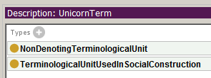
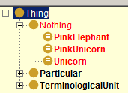
Classification of Terminological units can be used to steer classification of domain entities
Logical definition
Reference to term
Non Denoting
Undefined whether denoting

Slide 16
Inclusion of a branch "Terminological Unit" in an ontology

Slide 17
Thank You
stefan.schulz@medunigraz.at

Slide 18
Ficticious entities: used as metaphors or theme of delusions

Slide 19
Ficticious entities: used as metaphors or theme of delusions

Slide 20
Fictitious entities: used as metaphors or theme of delusions
Reprod Domest Anim. 2008 Jun;43(3):382-4. Epub 2007 Dec 30.
Case of pregnancy in two cows with unicorn horn of the uterus either by artificial insemination at ipsilateral or embryo transfer at contralateral corpus luteum in the ovary.
Moriyama C, Kobayashi I, Tani M, Oishi T, Kajisa M, Horii Y, Kamimura S.
Source
The United Graduate School of Veterinary Science, Yamaguchi University, Yoshida, Yamaguchi, Japan.
Abstract
Two Holstein heifers and a cow were diagnosed with White Heifer Disease by ultrasonography. Case 1 was a 14 month-old heifer with aplasia of both sides of the uterine horn. In case 2, a primiparous cow and case 3, an 18 month-old heifer, both showed aplasia of the right uterine horn. Case 2 became pregnant by artificial insemination at ipsilateral ovulatory follicle and corpus luteum in the left ovary, while case 3 became pregnant by embryo transfer at 7 days after oestrus with contralateral corpus luteum in the right ovary.

