Slide 1
MapReduce in the Cloud:
A study for efficient co-occurrence processing of MEDLINE annotations with MeSH
Markus Kreuzthaler, Jose Antonio Miñarro-Giménez and Stefan Schulz
Institute for Medical Informatics, Statistics and Documentation,
Medical University of Graz, Austria
HEC 2016, 30.08.2016, MI-2-5 Advanced analytics and Big Data

Slide 2

Introduction
PubMed/MEDLINE +24M records
Scopus +55M records
ScienceDirect +12M records
BioMed Central
Medscape
Google Scholar
HighWire +7M records
Notes:
2

Slide 3
Knowledge Types
Knowledge in biomedical terminologies
  Lexical: “cancer, “carcinoma”, “Krebs” have the same meaning.
  Ontological: “lung cancer is a cancer”, “lung cancer is located in the lung”, representing what is universally true.
Contingent knowledge
  Context-dependent: Sudden fever may be highly indicative for malaria in Sub-Saharan Africa but not in Central Europe.
  Probabilistic: Smokers have a higher risk for ling cancer
  Subject to temporal change: A drug was indicated to treat a certain disease in the past, but it is used for different purpose today, or has been withdrawn from the market.
Notes:
3

Slide 4
MEDLINE
Citations and abstracts from biomedical literature.
Contains +26 Million records maintained by NCBI at the U.S. NLM.
Index terms using the MeSH thesaurus support literature search, optimized regarding precision and recall.
Medical Subject Headings (MeSH)
  Controlled vocabulary
    ~27,800 descriptors
    ~87,000 entry terms
  Hierarchical structure
  Continually revised and updated
  Used for manual indexing of each publication in MEDLINE
Notes:
4

Slide 5
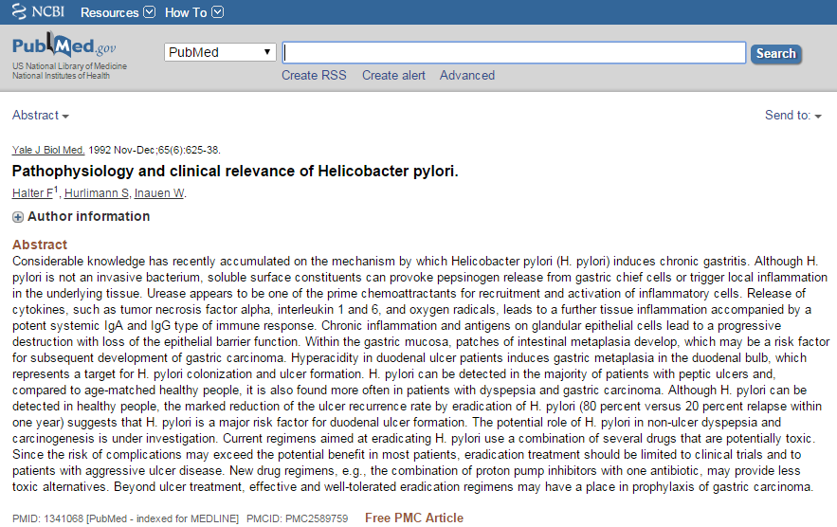
MEDLINE - PubMed
Notes:
5

Slide 6
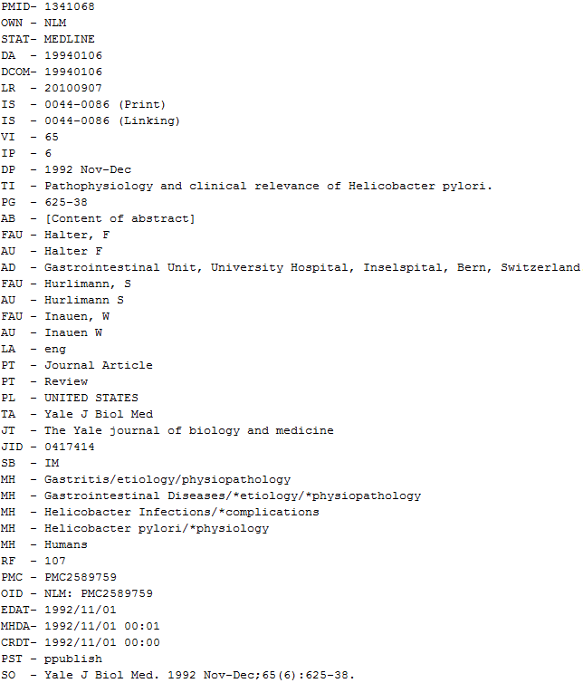
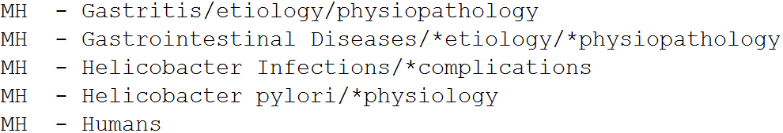
MEDLINE - PubMed
Notes:
6

Slide 7
MeSH - Subheadings
84 MeSH subheading types for refining the meaning of main headings
AB Abnormalities
AD Administration and Dosage
AE Adverse Effects
DT Drug Therapy
TU Therapeutic Use
… …
Can be seen as sparse feature vector per co-occurrence.
The co-occurrence is seen as a point in the 84 dimensional subheading space.
Notes:
7

Slide 8
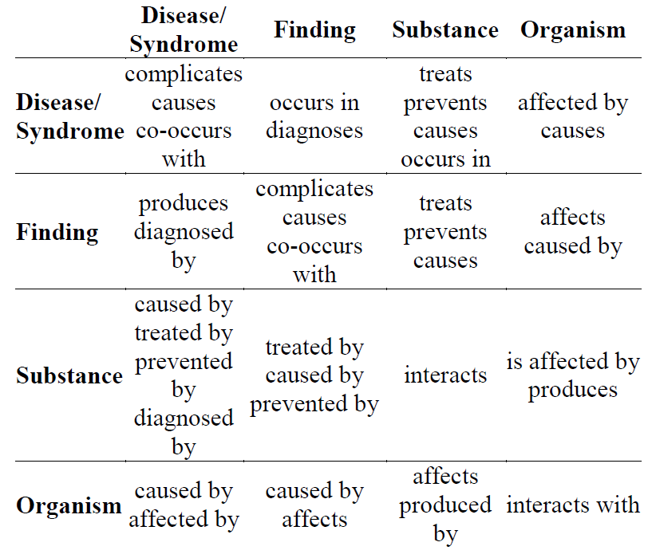
Hypothesis
Exploiting co-occurrence information together with subheading annotations provided by MeSH an additional knowledge layer can be build constituted by <SUBJ, PRED, OBJ> triples with predicates like:
Notes:
8

Slide 9
Material and Methods
Limitations:
  Focus on the semantic types Disease/Syndrome, Pharmacologic Substance
  Limit data set to MEDLINE records published in the last 5 years
  Concepts are flagged as major topic
Notes:
9

Slide 10
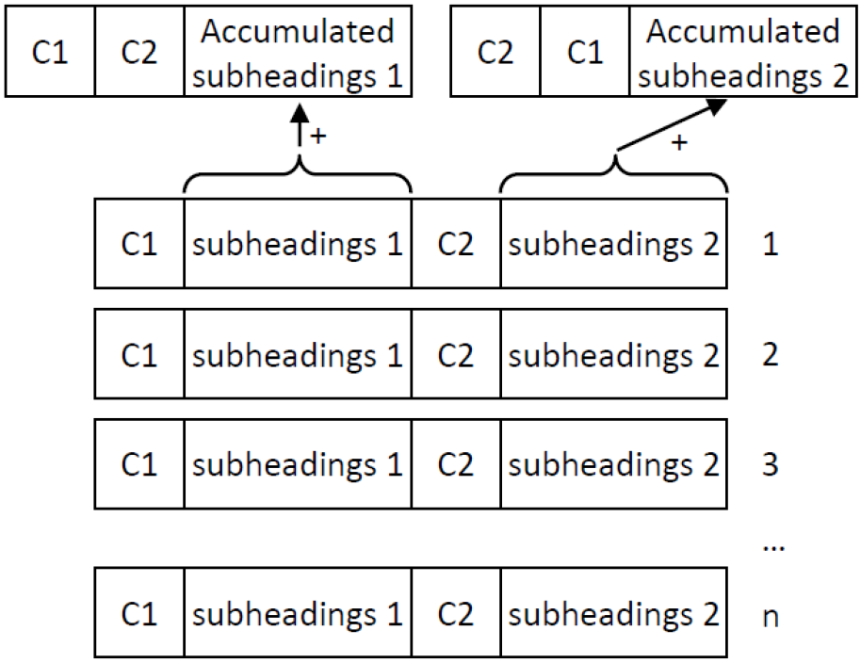
Material and Methods
Aggregate co-occurring concept pairs and their subheading vectors
UMLS MRCOC table as main processing resource (>10⁹ entries, 130 GB)
Notes:
10

Slide 11
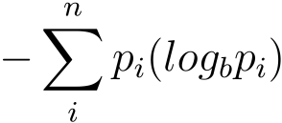
Material and Methods
Calculate the corresponding log-likelihood ratio scores (LLRs)
CUI = UMLS concept identifier
H =
LLR = 2 (H(matrix) - H(rows) - H(cols))
H(matrix) Matrix entropy
H(rows) Sum of row entropies
H(cols) Sum of column entropies
Co-occurence | CUI1 | ¬CUI1
CUI2 | #CUI1_CUI2 | #¬CUI1_CUI2
¬CUI2 | #CUI1_¬CUI2 | #¬CUI1_¬CUI2
Notes:
11

Slide 12
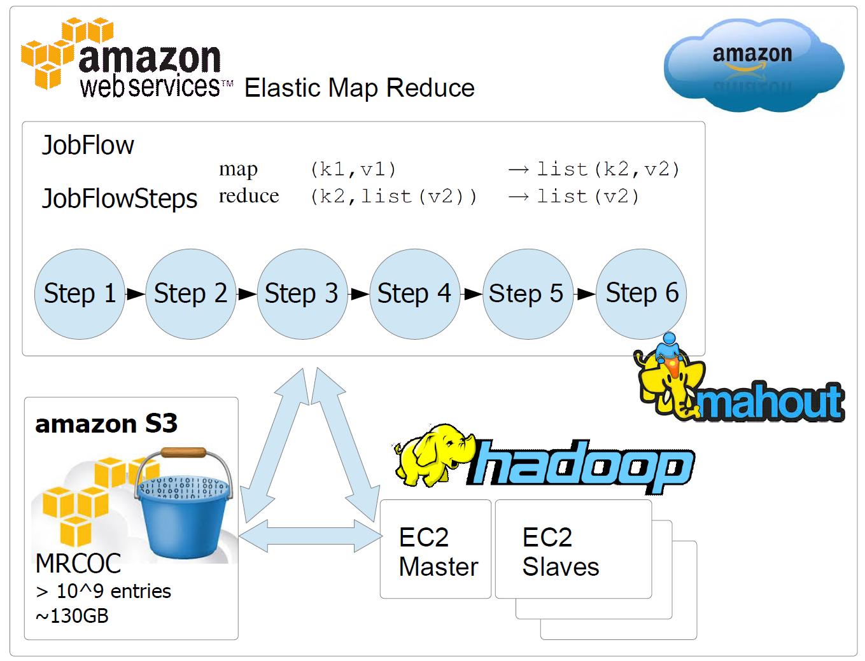
Material and Methods
Notes:
12

Slide 13
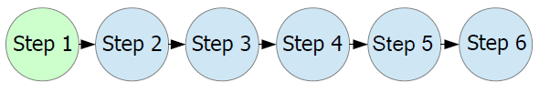
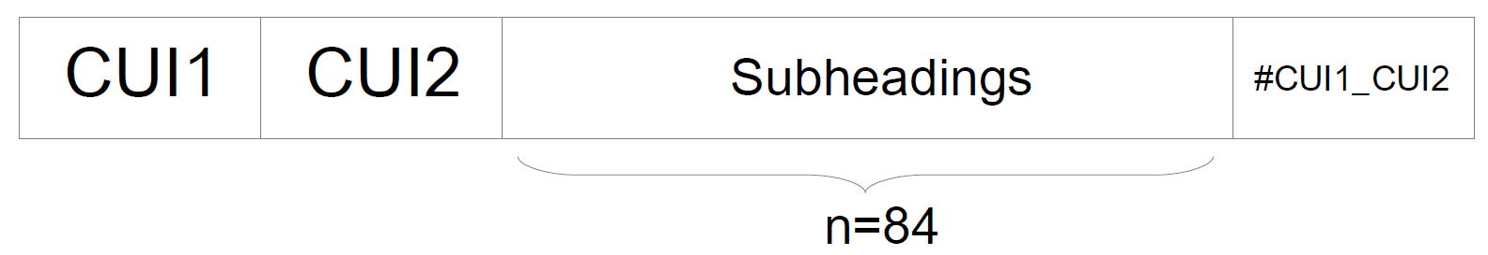
Material and Methods
Initial Filtering and Accumulation (IFAA)
  map (k1, v1) → list (CUI1_CUI2, SH_{i})
  reduce (CUI1_CUI2, list (SH₁, SH₁, SH_{i} …, SH_{n})) → list (SH₁, SH₁, SH_{i} …, SH_{n})
  list (SH₁, SH₁, SH_{i} …, SH_{n}) : (#SH₁, #SH_{i} …, #SH_{n})
Co-occurence | CUI1 | ¬CUI1
CUI2 | #CUI1_CUI2 | #¬CUI1_CUI2
¬CUI2 | #CUI1¬CUI2 | #¬CUI1¬CUI2
Notes:
13

Slide 14
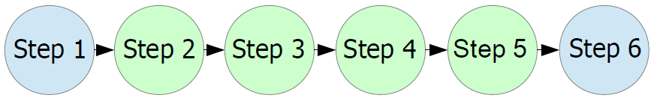

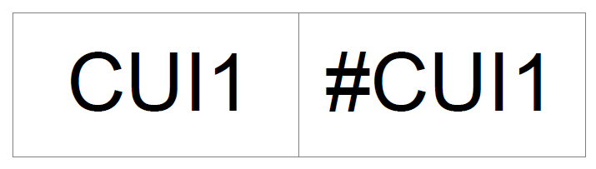

Material and Methods
Intermediate Occurrence Calculations (IMOC)
  Step 2: Overall counts OC
    map (k1, v1) → list (OC, 1)
    reduce (OC, list (1, 1, …, 1)) → list (1, 1, …, 1) : #1
  Step 3: CUI1 counts #CUI1
    map (k1, v1) → list (CUI1, 1)
    reduce (CUI1, list (1, 1, …, 1)) → list (1, 1, …, 1) : #1
  Step 4: CUI2 counts #CUI2
    map (k1, v1) → list (CUI2, 1)
    reduce (CUI2, list (1, 1, …, 1)) → list (1, 1, …, 1) : #1
Notes:
14

Slide 15
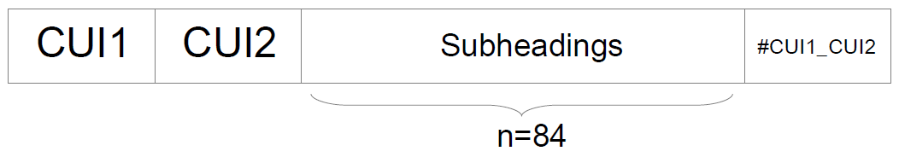
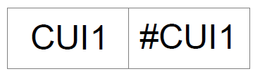
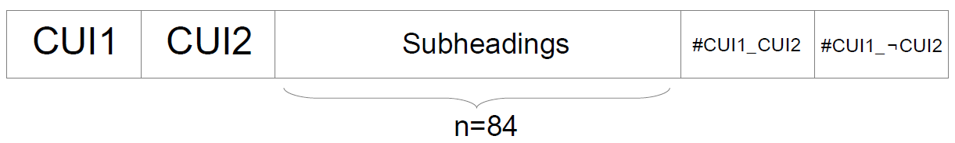
Material and Methods
Intermediate Occurrence Calculations (IMOC)
  Step 5: Reduce Side Join on CUI1
#CUI1¬CUI2 = #CUI1 - #CUI1_CUI2
Co-occurence | CUI1 | ¬CUI1
CUI2 | #CUI1_CUI2 | #¬CUI1_CUI2
¬CUI2 | #CUI1¬CUI2 | #¬CUI1¬CUI2
Notes:
15

Slide 16
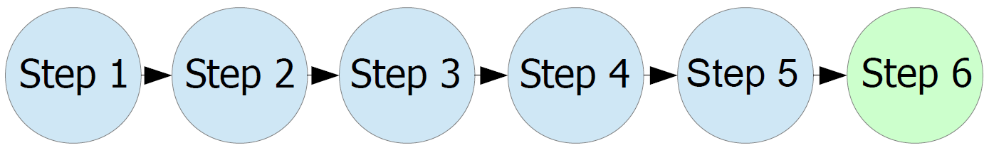
Material and Methods
Final Log-Likelihood Calculation (FLLC)
  Step 6: Reduce Side Join on CUI2
#¬CUI1_CUI2 = #CUI2 - #CUI1_CUI2
#¬CUI1¬CUI2 = OC - #CUI1_CUI2 - #CUI1¬CUI2 - #¬CUI1_CUI2
Notes:
16

Slide 17

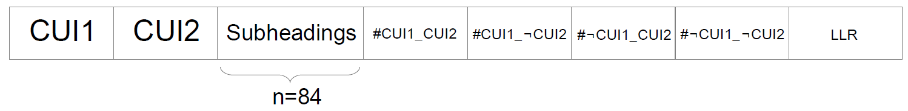
Material and Methods
Final Log-Likelihood Calculation (FLLC)
H =
LLR = 2 (H(matrix) - H(rows) - H(cols))
H(matrix): Matrix entropy; H(rows): Sum of row entropies; H(cols): Sum of column entropies
Co-occurence | CUI1 | ¬CUI1
CUI2 | #CUI1_CUI2 | #¬CUI1_CUI2
¬CUI2 | #CUI1¬CUI2 | #¬CUI1¬CUI2
Notes:
17

Slide 18
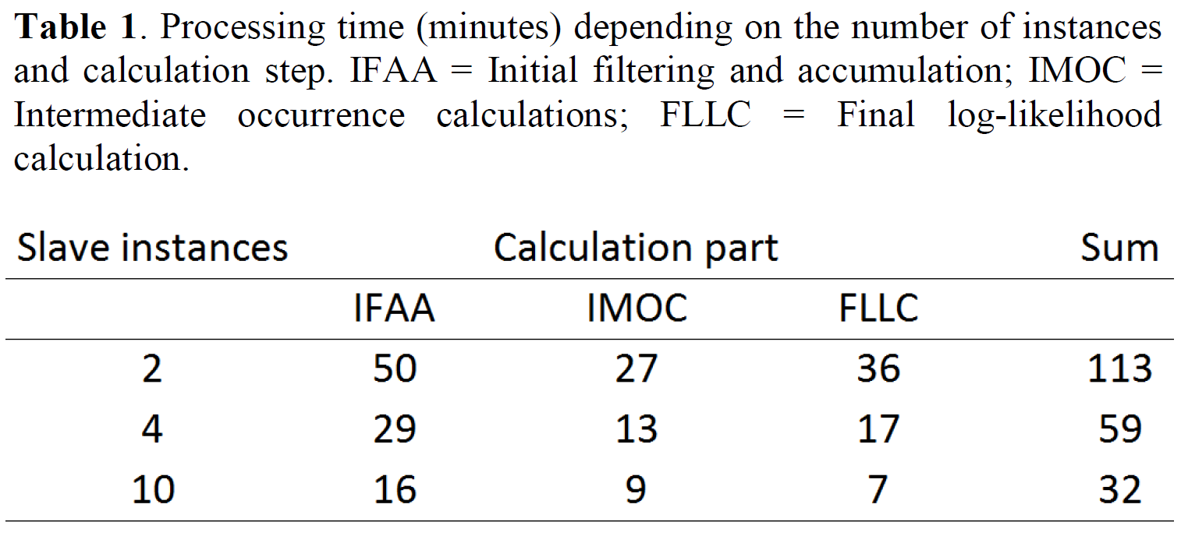
Results
Experimental setup
  Amazon instance information: Name: M1 General Purpose Medium; API Name: m1.medium; Memory: 3.75 GB; Compute Units (ECU): 2 units; Cores: 1 core; Storage: 410 GB; Arch: 32/64 bit.
  The task was not feasible on a single desktop machine without map/reduce applied.
Notes:
18

Slide 19


Conclusion and Outlook
Big Data approach (Amazon EC2, S3; Hadoop, Apache Mahout)
Some results
  Rash is associated with Antineoplastic Drugs; LLR=60.2
    chi-squared test, f=1, p<0.001, LLR>10.83
  Rash is caused by Antineoplastic Drugs (accuracy 0.85)
    clustering of subheading information [2]
Process abstracts
  NLP, SemRep, Subheading information [1]
  Use of Spark with uimaFIT in the future (DKPro)
Creation of an additional format of MRCOC which can be used by the scientific community in the future.
Virtualization on demand 10$
Buying dedicated hardware >>>>> 10$
Notes:
19

Slide 20
References and Acknowledgements
This work was performed as a part of the BMFacts project (BMFacts: Knowledge acquisition for a biomedical fact repository), funded by the Austrian Science Fund (FWF): [M 1729-N15].
[1] Miñarro-Giménez, J. A., Kreuzthaler, M., & Schulz, S. (2015). Knowledge Extraction from MEDLINE by Combining Clustering with Natural Language Processing. In AMIA Annual Symposium Proceedings (Vol. 2015, p. 915). American Medical Informatics Association.
[2] Miñarro-Giménez, J. A., Kreuzthaler, M., Bernhardt-Melischnig, J., Martínez-Costa, C., & Schulz, S. (2014). Acquiring Plausible Predications from MEDLINE by Clustering MeSH Annotations. Studies in health technology and informatics, 216, 716-720.
[3] Schulz, S., Costa, C. M., Kreuzthaler, M., Miñarro-Giménez, J. A., Andersen, U., Jensen, A. B., & Maegaard, B. (2014). Semantic relation discovery by using co-occurrence information. In 9th Language resources and evaluation conference (LREC).
Notes:
20

