Slide 1

Semantic Data
Platform for Healthcare
Philipp Daumke, Claudia Riede, Thomas Fassbender,
Ángel Honrado, Markus Kreuzthaler, Pablo López-García, Stefan Schulz, Erik van Mulligen, Herman van Haagen,
Jan Kors, Hanney Gonna, Xinkai Wang, Elijah Behr

Slide 2
General Goals
The aim of SEMCARE is to build a semantic data platform to support retrieval across large amounts of unstructured patient data for primary and secondary use cases. The platform identifies cohorts based on patient-level criteria (e.g. age, gender, diagnosis, indication, symptoms, lab results) scattered in heterogeneous clinical data.
Clinical Care
Research
Pharma
  Diagnosis Support
  Predictive Analytics
  Feasibility Studies
  Coding & Billing
  Hypothesis Validation
  Patient Recruitment
  Quality Management
  Semantic Interoperability
  Commercial Insights for Pharma

Slide 3
Timeline
Architecture & Requirements
Ethics
M15 First Release
M12-M24 Use Cases
M13 Review Meeting
Initial Terminology
Clinical Test Data
M1-M15 Main Software Development Phase
01/2014
12/2015

Slide 4










Partners
European Commission
FP7 ICT Project - End date: 31-Dec-2015
Scientific Coordinator, Language Technology Provider,
Commercial Exploitation
Leading Clinical Partner & Content Provider, Usability
& Evaluation
Language Technologies for Dutch, Terminology,
Clinical Content Provider
Terminology/Ontology Expert, Language Technologies
for German, Clinical Content Provider
Project Manager, Commercial Exploitation,
Communication Planning

Slide 5
SEMCARE Text Analytics Pipeline

Slide 6
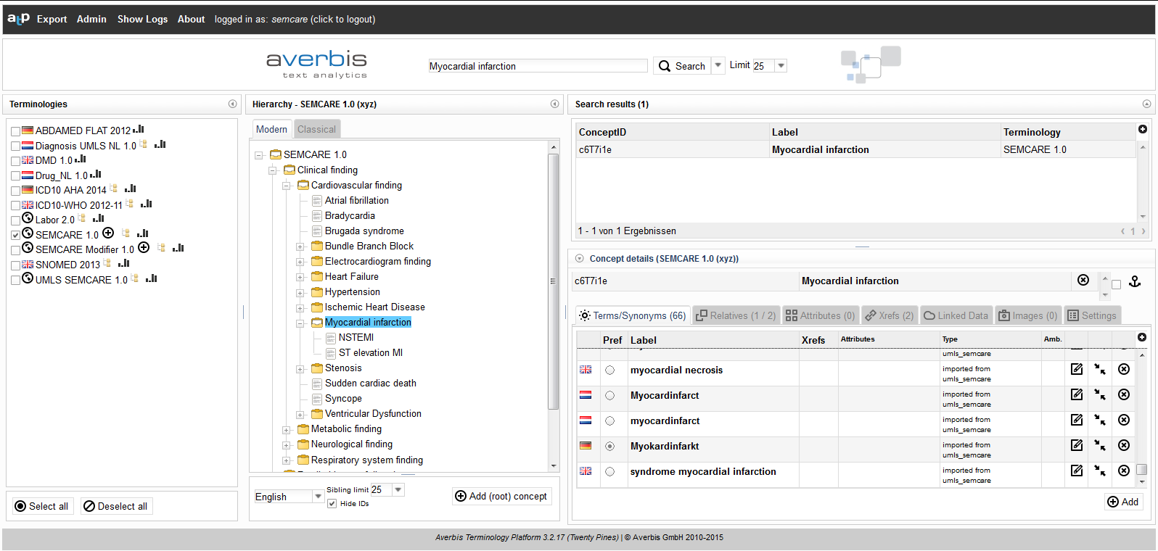
Terminology management
Notes:
Integration of different terminologies
Parallel search within and across different terminologies
Creation, editing and deletion of terminologies and concepts
Automated synonym enrichment
Multilingual support
NLP view of a terminology

Slide 7
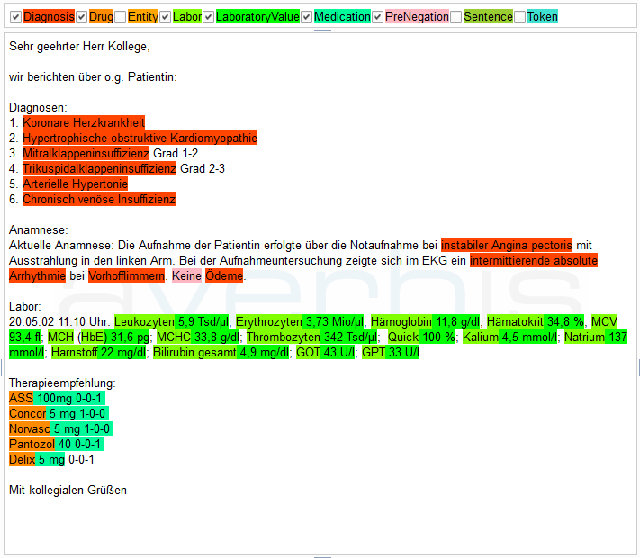
Text mining
Notes:
Integration of different terminologies
Parallel search within and across different terminologies
Creation, editing and deletion of terminologies and concepts
Automated synonym enrichment
Multilingual support
NLP view of a terminology

Slide 8
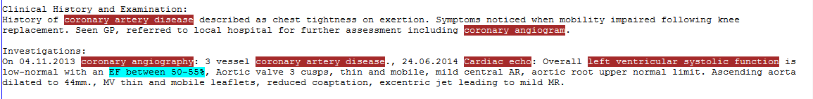
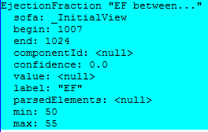
Identification of observables, numbers, units

Slide 9
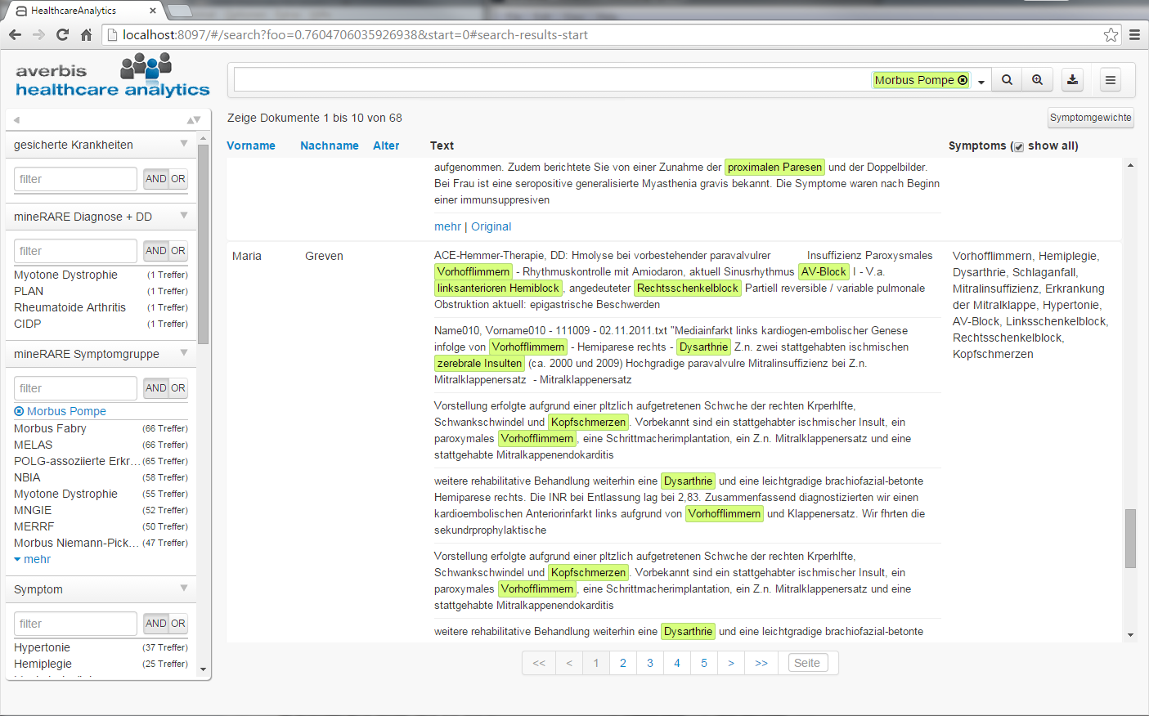
Cohort Finder
Notes:
Integration of different terminologies
Parallel search within and across different terminologies
Creation, editing and deletion of terminologies and concepts
Automated synonym enrichment
Multilingual support
NLP view of a terminology

Slide 10
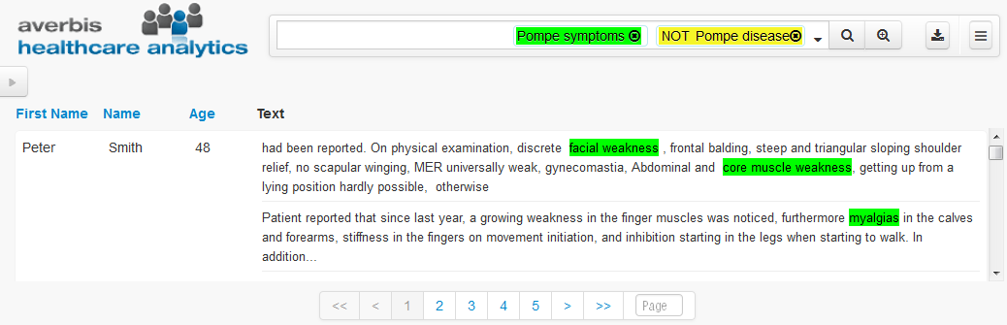
Diagnosis Support
Show me all patients with typical Morbus Pompe symptoms,
but without a Morbus Pompe diagnosis

Slide 11
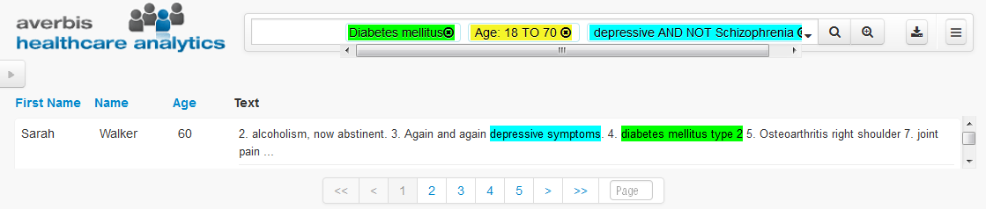
Feasibility Studies
Show me all patients without ‚diabetes mellitus‘, age between 18 and 70,
and symptoms of depression, but without schizophrenia

