Slide 1
German-Language Content in Biomedical Vocabularies
Stefan Schulz^{a,e}, Josef Ingenerf^{b}, Sylvia Thun^{c}, Philipp Daumke^{d}, Martin Boeker^{e}
ªInstitute for Medical Informatics, Statistics and Documentation, Medical University of Graz, Austria
^{b}Institute for Medical Informatics, University of Lübeck, Germany
^{c}University of Niederrhein, Krefeld, Germany
^{d}Averbis GmbH, Freiburg, Germany
^{e}Institute of Medical Biometry and Medical Informatics, University of Freiburg, Germany
Schulz S, Boeker M – BioTopLite – An Upper Level Ontology for the Life Sciences – ODLS 2013

Slide 2
Biomedical Vocabulary
Umbrella term for
Classification, Nomenclature, Terminology, Ontology, Catalogue
Building blocks
Representational units: the primary identifiers of meaning (RUs, concepts, classes, synsets)
Links: the connections between RUs, such as broader/narrower, is-a, part-of
Codes: alphanumeric identifiers for a concept
Terms: words or group of words that describe the meaning of a RU in human language.
Hierarchies: network of links that constitute a partial order (single or multiple hierarchies)
Axes: systems of independent, non-overlapping hierarchies
Glossary entries (scope notes): natural language elucidations of concept meaning and use
Axioms: sentences expressed in logic providing formal, computable definitions for concepts
Rules: directives that specify exclusion and inclusion criteria in classifications

Slide 3
Genres of Biomedical Vocabularies
Thesauri: describe the meanings of pre-existing terms and relate them using semantic relations
synonymy / broader…narrower
Classifications:
Subclass hierarchies
tendency to artificial names
arbitrarily restricted meanings due to class disjointness
Ontologies
logic-based foundation
concepts represent types of entities rather than meaning of words
[MeSH]
Blood
Blood plasma
Fetal blood
"In-vitro-Bestimmung des Genexpressionsprofils mittels RNA aus Monozyten des peripheren Blutes bei Zustand nach Transplantation"
E10: Insulin-dependent diabetes mellitus
Excl. complications of pregnancy, childbirth and the puerperium (O00-O99)
SCT: Cholecystitis subClassOf
Associated morphology some Inflammation and
Finding site some Gallbladder structure

Slide 4
Survey
ICD-10
OPS
ICD-O
MeSH
MEDDRA
LOINC
ATC
ICF
SNOMED /Wingert Nomenclature
RADLEX
EDQM
UCUM
ICPC
ICNP
Fee catalogues for procedure-based reimbursement
Sources for Latin terms
Domain-independent terminology sources

Slide 5
ICD 10
Two German versions:
Mortality (WHO): 14,400 RUs
Morbidity (DIMDI): ICD-10 GM (12,500 concepts) extensions, pruning of subhierarchies
Alphabetical Index: 77,000 terms linked to ICD-10 GM identified by Alpha ID
Synonyms
more specific entry terms, e.g. "Amoxicillin-Allergie" [I112547] → T88.7 (Unspecified adverse effect of drug or medicament).
- Arm - - beim Fetus P03.1 - - Fetus, Betreuung, Mutter O32.2 - - Hindernis, Geburt O64.4 - - Komplikation, Entbindung O32.2 - - mit Schnittentbindung O32.2 - Bandscheibe M51.2 - - lumbal M51.2 - - lumbosakral M51.2 - - mit - - - Ischialgie M51.1† G55.1 - - - Kompression, Rückenmark a.n.k. M51.0† G99.2 - - - Lendenwirbelsäulensyndrom M51.1† G55.1 - - - Neuritis M51.1† G55.1 - - - Zervikalsyndrom M50.1† G55.1 - - thorakal M51.2 - - zervikal M50.2 - - - mit - - - - Kompression, Rückenmark M50.0† G99.2 - - - - Myelopathie M50.0† G99.2

Slide 6
OPS
Procedure coding system, only used in Germany and Austria
Adaptation of the WHO's International Classification of Procedures in Medicine (ICPM)
28,300 concepts
Alphabetical index
Watch out: Abbreviated class labels
1-497 Transvenöse oder transarterielle Biopsie
1-497.0 Endokard
1-497.1 Endomyokard
1-497.2 Myokard
1-497.3 Leber
1-497.x Sonstige
1-497.y N.n.bez.

Slide 7
MeSH
Indexing vocabulary for biomedical literature (not recommended for EHR)
28,300 concepts (main headings )
German version: and 60,067 German entry terms (compared to 193,000 English entry terms)
No translation of scope notes
Annual update (DIMDI)
MeSH Heading | Hip Fractures
Tree Number | C26.404.061.425
Tree Number | C26.404.484
Tree Number | C26.531.750
Tree Number | C26.558.276.425
Annotation | GEN or unspecified; note X refs: fract below subtrochant = FEMORAL FRACTURES; FEMORAL NECK FRACTURES is available; femur head fract = FEMUR HEAD / inj (IM) + HIP FRACTURES (IM); acetabular fract = ACETABULUM / inj (IM) + FRACTURES, BONE (IM)
Scope Note | Fractures of the FEMUR HEAD; the FEMUR NECK; ( FEMORAL NECK FRACTURES); the trochanters; or the inter- or subtrochanteric region. Excludes fractures of the acetabulum and fractures of the femoral shaft below the subtrochanteric region ( FEMORAL FRACTURES).
Entry Term | Intertrochanteric Fractures
Entry Term | Subtrochanteric Fractures
Entry Term | Trochanteric Fractures

Slide 8
SNOMED CT
emerging international standard, maintained by the IHTSDO (International Health Terminology Standards Development Organisation), approx. 311,000 concepts, ontology based, biannual update
German speaking countries so far no IHTSDO members
Non-released German translation from 2004 (362,000 concepts, ~1M terms)

Slide 9
Wingert nomenclature
Origin: SNOMED v2
multiaxial nomenclature
German translation (1984) available as "Wingert nomenclature", maintained by private SW company
D5-46210 Acute appendicitis, NOS
D5-46100 Appendicitis, NOS
G-A231 Acute
M-41000 Acute inflammation, NOS
G-C006 In
T-59200 Appendix, NOS
G-A231 Acute
M-40000 Inflammation
G-C006 In
T-59200 Appendix, NOS

Slide 10
RadLex
Vocabulary of standardized radiological terms for structured reporting in medical imaging
30,000 concepts
6,240 German translations

Slide 11
MedDRA
Terminology for the drug regulatory process
signs, symptoms, diseases, procedures, investigation results and therapeutic indications
German translation: 92,000 German terms
different kinds of synonymy relations

Slide 12
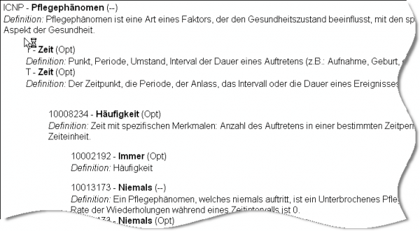
ICNP - International Classification of Nursing Practice
Vocabulary for nursing diagnoses, interventions, and results
2800 concepts
Multiaxial terminology system, increasingly ontology and logic-based.
German version is maintained by the German ICNP User Group

Slide 13
Special cases
Catalogues for reimbursement, drugs, devices
Sources for Latin terms
Domain-independent terminology sources

Slide 14
Catalogues
Fee schemes for the ambulatory sector
Terms + defined descriptions, exclusions inclusions
Similar for devices (eClass) and drugs (ABDA)
34291 Herzkatheteruntersuchung mit Koronarangiographie
Obligater Leistungsinhalt
Herzkatheteruntersuchung mit Koronarangiographie,
Begleitleistungen, die im unmittelbaren Zusammenhang mit der Leistungserbringung stehen,
Kontrastmitteleinbringung(en),
Fakultativer Leistungsinhalt
Selektive Darstellung auch bei Patienten mit einem oder mehreren Bypässen und/oder bei Patienten mit Herzvitium,
Angiokardiographie (Nr. 34290),
Gerinnungsuntersuchung(en) (z. B. aktivierte Gerinnungszeit),
einmal im Behandlungsfall 8865 Punkte

Slide 15
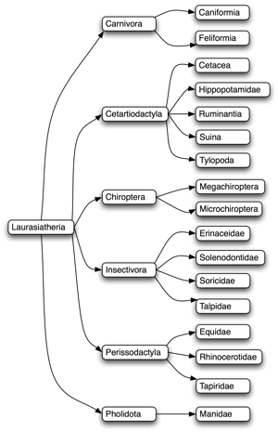
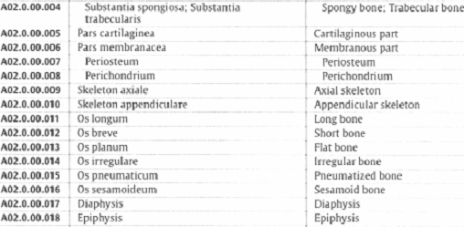
Sources for Latin terms
Use of Latin terms (with Latin inflections) in German text
Organisms ("Homo sapiens", "Drosophila melanogaster")
Anatomy ("Vena cava superior", "Papilla Vateri")
International sources:
NCBI taxonomy for organisms
Terminologia Anatomica (Latin and English)

Slide 16
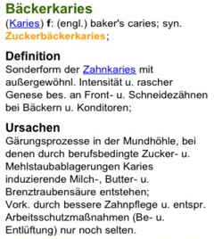
Lexical German resources
GermaNet
Lexico-semantic network, similar to WordNet under construction
85,000 concepts (synsets), 111,000 terms, 100,000 linkages
Coverage not domain specific, but potential source for layperson terms
Rubrics in medical lexicons
Pschyrembel
Roche Lexicon
Wikipedia

Slide 17
General observations
Localised versions modify the international version (ICD)
No international version available (OPS)
Localized version incomplete (RADLEX)
Localized version outdated (SNOMED CT)
Localized version unavailable (Wingert, SNOMED CT)
Localized versions maintained by public body (DIMDI): ICD, MeSH
Localized versions maintained by user groups (ICPM)
Additional source of terminology
National catalogues (procedures, drugs, devices):
Latin Sources
Medical and general lexicons

Slide 18
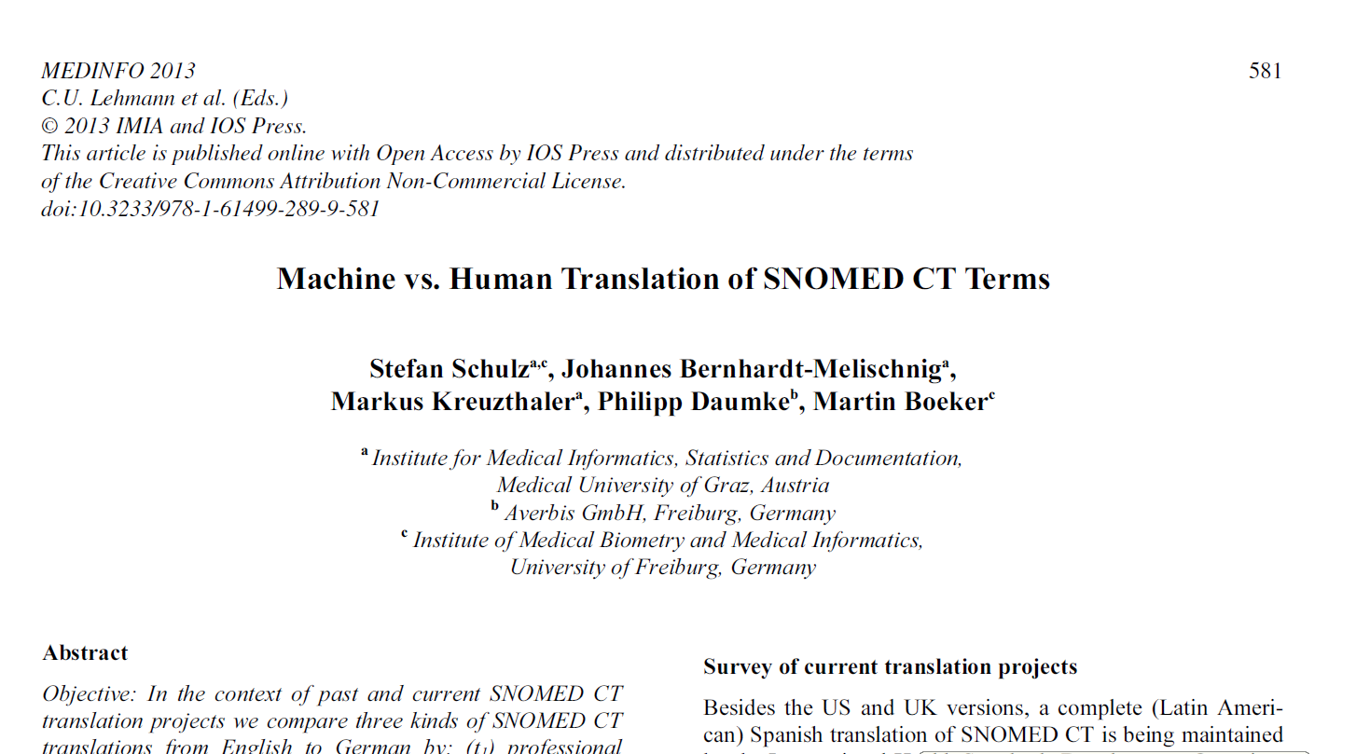
Machine translation / crowdsourcing

