Slide 1
Does Medical Image Simulation Require Formal Ontologies?
Stefan Schulz Medical University of Graz (Austria)
purl.org/steschu
VIP – Virtual Imaging Workshop
Lyon, France, Dec 14th, 2012

Slide 2
What are (formal) Ontologies?

Slide 3
What are (formal) Ontologies?
Computer science view
Ontologies are purpose-oriented formal models of meaning (conceptualizations)
Cognitive / linguistic view
Ontologies are concept systems or systems of semantic reference (no clear distinction from thesauri)
Also adopted by parts of the Semantic Web community
Philosophy view (scientific realism)
Ontology is the study of what there is
Formal Ontologies give precise mathematical formulations of the properties and relations of certain entities.
Quine O. On what there is. In: Gibson R. Quintessence - Basic Readings from the Philosophy of W. V. Quine. Cambridge: Belknap Press, Harvard University, 2004.
Schulz S, Stenzhorn H, Boeker M, Smith B: Strengths and limitations of formal ontologies in the biomedical domain. RECIIS - Electronic Journal in Communication, Information and Innovation in Health, 2009; 3 (1): 31-45:

Slide 4
Formal ontology in a nutshell
Formal ontology = logic based ontology
Description logics: subset of first order logic
Common standard: OWL (Ontology Web Language)
Ontologies are taxonomies of classes
Ontologies can define classes in terms of (Aristotelian) definitions
Subclass (aka is-a): A subClassOf B iff ∀a:A(a) → B(a)
Primate subClassOf Vertebrate
Equivalence: X equivalent to Y and some r Z iff ∀x:X(x) ↔ Y(x) ∧ ∃z:C(z) ∧ r(x,z)
Vertebrate equivalentTo Animal and hasPart some Vertebra
Vertebrate
subClassOf
Primate
subClassOf
Homo Sapiens

Slide 5
Taxonomy as Venn diagram
Every human is a primate, every primate is a vertebrate
Human subClassOf Primate
Transitivity: Every human is a vertebrate
Class: Vertebrate
Class: Primate
Class: Homo S.
Class: Homo S.
Tristan
Bernard
Washoe
Stefan
Koko
Bobo

Slide 6
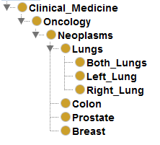
Doing taxonomy right
∀a:A(a) → B(a) ⇔ ¬∃a: A(a) ∧¬ B(a)
Test :
there is no neoplasms that is not an oncology
there is no prostate that is not a neoplasm
there is no oncology that is not a clinical medicine

Slide 7
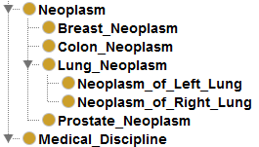
Doing taxonomy right
∀a:A(a) → B(a) ⇔ ¬∃a: A(a) ∧¬ B(a)
Test :
oncology is an instance of a medical discipline
there is no prostate neoplasm that is not a neoplasm
Labelling !
http://en.wikipedia.org/wiki/OntoClean
Schober D, Smith B, Lewis SE, Kusnierczyk W, Lomax J, Mungall C, Taylor CF, Rocca-Serra P, Sansone SA.Survey-based naming conventions for use in OBO Foundry ontology development. BMC Bioinformatics. 2009 Apr 27;10:125. doi: 10.1186/1471-2105-10-125.

Slide 8
Formal ontology in a nutshell
Formal ontology = logic based ontology
Description logics: subset of first order logic
Common standard: OWL (Ontology Web Language)
Ontologies are taxonomies of classes
Ontologies can define classes in terms of (Aristotelian) definitions
Subclass (aka is-a): A subClassOf B iff ∀a:A(a) → B(a)
Primate subClassOf Vertebrate
Equivalence: X equivalent to Y and some r Z iff ∀x:X(x) ↔ Y(x) ∧ ∃z: C(z) ∧ r(x,z)
Vertebrate equivalentTo Animal and hasPart some Vertebra
Vertebrate
subClassOf
Primate
subClassOf
Homo Sapiens

Slide 9
Aristotelian Definitions: Genus proximum and differentia specifica
Viral Hepatitis
located in
Liver
Viral Infection
ViralHepatitis equivalentTo ViralInfection and locatedIn Liver
Test :
There is no viral hepatitis that is not located in a liver
There in no viral hepatitis that is not a viral infection

Slide 10
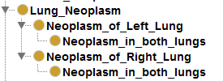
Ontological Commitment
Which are the instances?
Does the label tell us what is meant?
Is there an implicit context?
Test :
There is no neoplasm in both lungs that is not a neoplasm in the left lung
There is no varicose vein in the lower limb that is not a chronic peripheral venous insufficiency
There is no patient with neoplasm in both lungs that is not a patient with the neoplasm in the left lung
There is no patient with varicose lower limb veins that is not a patient with a chronic peripheral venous insufficiency

Slide 11
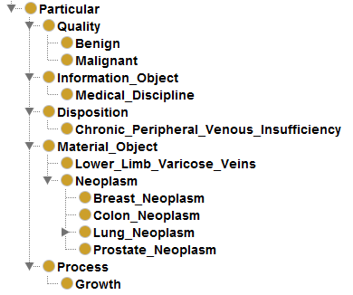
Upper level ontologies: partition of the domain into disjoint and exhaustive categories
Process
Quality
Material Object
Information Object
Upper level ontologies enforce a strict categorization
Constraints on upper-level categories
Upper level ontology for the biomedical domain BioTop
Disposition
http://purl.org/biotop

Slide 12
How formal ontologies challenge human cognition
Built around taxonomies of classes
ATTENTION: our intuitive way of hierarchically organize terms is not strictly taxonomic
State what is true for all individual members of a class (instances of a type)
Requires to distinguish between classes and individuals
ATTENTION: human language is often misleading, e.g. Lyon is a big city vs. The liver is a big organ
Individuals commit to upper-level categories
ATTENTION: our thinking fuses mutually dependent entities that belong to different categories, e.g. Cancer (growth process vs. mass of malignant tissue)
Upper level categories should be made explicit
Explicit upper level ontology – common understanding
Implicit upper level ontology of each of us – misunderstanding

Slide 13
What formal ontology is not
Ontology ≠ Knowledge representation
"There are very few interesting items of knowledge that are truly ontological in this strict sense" (Alan Rector)
antinomy: ὄντος (being) vs. ἐπιστήμη (knowledge)
Ontology is not appropriate for
Default knowledge
"The hand has 5 fingers" (unless otherwise stated)
Probabilistic knowledge
Mesothelioma is a rare cancer
Contingent knowledge
Aspirin prevents myocardial infarction
Jaundice is a typical symptom of hepatitis

Slide 14
Why formal ontology at all ??
Formal definitions create maximum consensus on the meaning of terms
Ontologies as standards
Reusable terms and axioms
Formal axioms encode statements about what is considered to be universally true in a domain
in contrast to knowledge proper
Formal axioms permit logic-based reasoning
Consistency checking
New entailments
Equivalence of syntactically heterogeneous expressions can be computed: semantically interoperable systems

Slide 15
Ontologies in life sciences and health care

Slide 16
Ontologies in life sciences and health care
Bottom-up ontology development: OBO (Open biomedical Ontologies) Foundry
Top-down ontology development: SNOMED CT (Systematized Nomenclature of Medicine – Clinical terms)

Slide 17
OBO Foundry: Orthogonality by Upper-level, and Granularity divisions
RELATION TO TIME GRANULARITY | CONTINUANT |  |  |  | OCCURRENT
 | INDEPENDENT |  | DEPENDENT
ORGAN AND ORGANISM | Organism (NCBI Taxonomy) | Anatomical Entity (FMA, CARO) | Organ Function (FMP, CPRO) | Phenotypic Quality (PaTO) | Biological Process (GO)
CELL AND CELLULAR COMPONENT | Cell (CL) | Cellular Component (FMA, GO) | Cellular Function (GO)
MOLECULE | Molecule (ChEBI, SO, RnaO, PrO) |  | Molecular Function (GO) |  | Molecular Process (GO)
Smith, B.; Ashburner, M.; Rosse, C.; Bard, J.; Bug, W.; Ceusters, W.; Goldberg, L. J.; Eilbeck, K. et al. (2007). "The OBO Foundry: Coordinated evolution of ontologies to support biomedical data integration".Nature Biotechnology 25 (11): 1251–1255. doi:10.1038/nbt1346

Slide 18
The OBO Foundry
Collaborative bottom up initiative, driven by the success of the Gene Ontology
Rooted in upper ontologies (BFO + RO)
Goal of creating a suite of orthogonal interoperable reference ontologies in the biomedical domain
Moving from semi-formal OBO syntax to OWL-DL
Cross-ontology definitional axioms:
Calcitonin secreting cell (Cell Ontology) can be defined as a Secretory cell which secretes Calcitonin (ChEBI)
Heart development (Gene Ontology) can be defined as a Developmental process which has Heart (FMA) as participant
Smith, B.; Ashburner, M.; Rosse, C.; Bard, J.; Bug, W.; Ceusters, W.; Goldberg, L. J.; Eilbeck, K. et al. (2007). "The OBO Foundry: Coordinated evolution of ontologies to support biomedical data integration".Nature Biotechnology 25 (11): 1251–1255. doi:10.1038/nbt1346

Slide 19
SNOMED CT (Systematized Nomenclature of Medicine - Clinical Terms)
http://www.ihtsdo.org/

Slide 20
SNOMED CT - clinical terminology with ontological foundations
Terminology for clinical data covering diseases, findings, procedures, organisms, substances etc.
311, 000 concepts, connected by 1,360,000 relational expressions
Definitions with DL axioms
Promoted as an international terminological standard"

Slide 21
SNOMED CT: Terminology + Ontology
Concepts (represent-ational units)
DL Axioms
Terms
http://viw2.vetmed.vt.edu/sct/menu.cfm

Slide 22
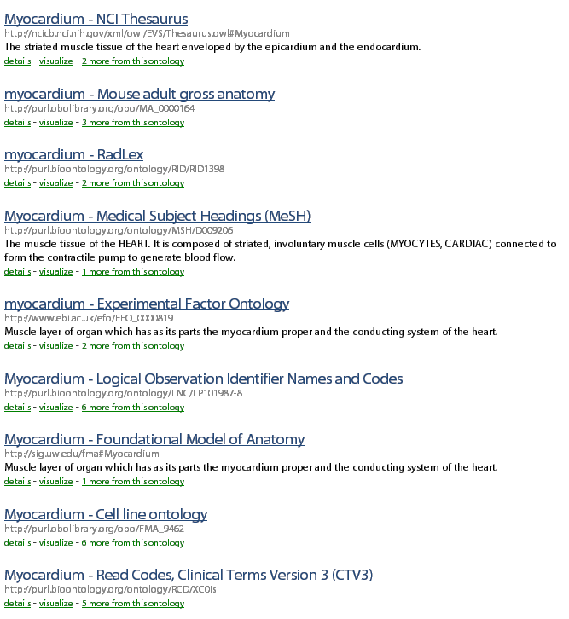
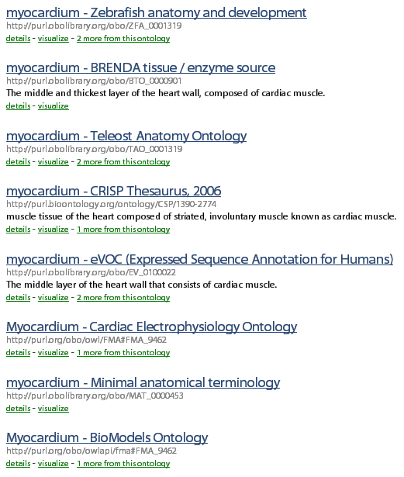
Bioportal – repository for biomedical ontologies
Submit your ontology to http://bioportal.bioontology.org

Slide 23
Formal ontologies and beyond…
http://bioportal.bioontology.org

Slide 24
Alternative to formal ontologies: INFORMAL terminologies / thesauri

Slide 25
Alternative to formal ontologies: INFORMAL terminologies / thesauri
Group together words / terms according to similarity in meaning
Basic relations:
Synonymy
Broader / Narrower (ordering relations)
Concept = Group of (quasi)synonyms
Multiple hierarchies
Mainly designed for retrieval
Text definitions / explanations (scope notes) if required
No formal semantics
Freitas F, Schulz S, Moraes E: Survey of current terminologies and ontologies in biology and medicine. RECIIS - Electronic Journal in Communication,Information and Innovation in Health, 2009; 3 (1): 7-18:http://dx.doi.org/10.3395/reciis.v3i1.239en

Slide 26
MeSH - Medical Subject Headings
http://www.nlm.nih.gov/mesh/

Slide 28
Example: Medical Subject Headings (MeSH)
Literature search: monoclonal antibodies and cancer therapy
MeSH terms

Slide 29
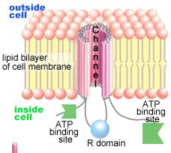
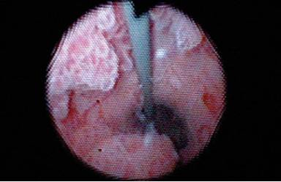
"Nontologies"
Use OWL syntax, which should not be interpreted according to description logics semantics
Formal reasoning would lead to incorrect entailments
Examples: NCI thesaurus, Radlex
Many other ontologies contain problematic axioms that contradict the intended meaning
Example (NCI thesaurus): Calcium-Activated_Chloride_Channel-2 subClassOf Gene_Product_Expressed_In_Tissue some Lung and Gene_Product_Expressed_In_Tissue some Mammary_Gland and Gene_Product_Expressed_In_Tissue some Trachea
Ureter_Small_Cell_Carcinoma subclassOf Disease_May_Have_Finding some Pain
Schulz S, Schober S, Tudose I, Stenzhorn H: The Pitfalls of Thesaurus Ontologization – the Case of the NCI Thesaurus. AMIA Annu Symp Proc, 2010: 727-731

Slide 30
(N)ontologies of interest for imaging
Radlex
24800 classes covering anatomy, procedures, diseases, substances, devices, relevant for radiologic imaging
all classes are also individuals (punning)
Relations ('is a', 'part of') asserted are at the level of individuals
On classes no other axioms than subclass axioms
Foundational model of anatomy
Complete model: Protégé Frames (no formal semantics) Parts of it available as OWL
All assertions at class level
Logical entailments only true for "canonical" anatomy
SNOMED CT

Slide 31
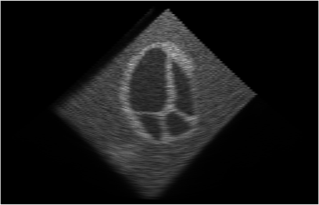
Challenges of "correct" ontology for image representation including simulation
Same terms (e.g. "cardiac motion") can be used for different things
A real cardiac motion in a patient (process)
Part of an image (information entity) that represents a real cardiac motion
A simulation artifact (information entity), which does not refer to any specific cardiac motion
The "concept" cardiac motion (cognitive entity)
If you prefer 4. or if the distinction between 1. – 4. does not matter, then you shouldn't use formal ontologies

Slide 32
Where ontologies or thesauri are sufficient
Provision of controlled terms
Good text definitions should be available
Hierarchy expansion for retrieval
hierarchical links at the level of broader term / narrower terms
is-a → is narrower than
part-of → is narrower than
"Hand-crafted" inference rules
no use of description logics classifiers
Possible standard SKOS
http://www.w3.org/2004/02/skos/intro

Slide 33
Own experiences with ontologies in large projects
EU funded projects with multiple partners
@neurIST: Data integration (clinical, genomic, simulation) on cerebral aneurysms
DebugIT: Decision support system for infectious diseases
SemanticHealthNet: Semantic interoperability between heterogeneous semantic representations in the EHR
Experiences:
in 1. and 2. much effort put in formal ontology
Mostly used as a controlled vocabulary (1.)
DL reasoning only for computing inferred ontology, which then used with production rules
3. Formal foundation seems fundamental to reach the interoperability goal. However, intellectual input considerable and scalability still open

Slide 34
Current state of the art of Applied Ontology as a discipline

Slide 35
Current state of the art of Applied Ontology as a discipline
Applied Ontology – still emerging discipline
Prevalence of makeshift ontology artifacts
Ontology engineering required to be more principled
Necessary resources
Standards (Semantic Web – OWL )
Good practice guidelines (e.g. GoodOD Guideline)
Quality management
Best-of-breed examples
Industry-standard tools
Editors
Reasoners
http://www.iph.uni-rostock.de/GoodOD-Guideline.1299.0.html

Slide 36
Current state of the art of Applied Ontology as a discipline
http://www.iph.uni-rostock.de/GoodOD-Guideline.1299.0.html

Slide 37
Current state of the art of Applied Ontology as a discipline
Applied Ontology – still emerging discipline
Prevalence of makeshift ontology artifacts
Ontology engineering required to be more principled
Necessary resources
Standards (Semantic Web – OWL )
Good practice guidelines (e.g. GoodOD Guideline)
Quality management
Best-of-breed examples
Industry-standard tools
Editors
Reasoners
http://www.iph.uni-rostock.de/GoodOD-Guideline.1299.0.html

Slide 38
Decision on using formal ontology in life science research projects
Functional requirements
Controlled terminology
Query expansion for retrieval
Precise definitions of terms
Precise classification of domain entities
Reasoning to establish semantic equivalence
Representation of contingent knowledge
Default reasoning
Probabilistic reasoning

Slide 39
Decision matrix Thesauri / Ontologies / KR formalism
thesauri
ontology
KR
Controlled domain language | x
Query expansion for retrieval | x x
Precise definitions of terms | x x
Precise classification of domain entities | x x
Reasoning to establish semantic equivalence | x x
Representation of contingent knowledge | x x x
Non-monotonic reasoning | x x x
Probabilistic reasoning | x x x

Slide 40
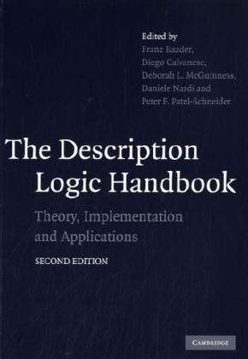
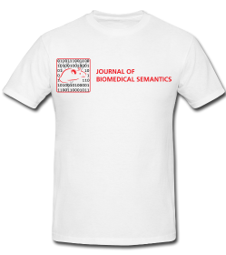
Further readings

Slide 41
Ontology on the Web
Description Logics: http://dl.kr.org/
Protégé: http://protege.stanford.edu/
Bioontology: http://www.bioontology.ch/
Buffalo Ontology Site: http://ontology.buffalo.edu/smith/
OBO Foundry: http://obofoundry.org/
Bioportal: http://bioportal.bioontology.org/
SNOMED CT: http://www.ihtsdo.org/snomed-ct/ http://terminology.vetmed.vt.edu/sct/menu.cfm
CO-ODE (Pizza ontology): http://www.co-ode.org/
GoodOD Guideline: http://www.iph.uni-rostock.de/GoodOD-Guideline.1299.0.html

