Slide 1
Ontological Analysis, Ontological Commitment, and Epistemic Contexts
Stefan Schulz
WHO – IHTSDO Joint Advisory Group
First Face-to-Face Meeting
Heathrow, London
15-16 Dcember 2010

Slide 2
Ontological analysis
What do the representational units in a representational artifact represent?
members of classes
instances of concepts
denotation of terms
What are the entities they are dependent on (without what they can’t exist) ?
In which upper level categories do they belong ?
From a description logics perspective most SCT concepts are classes

Slide 3
Classes and their extensions
2
3
4
5
6
z
m
a
k
q
x
u

Slide 4
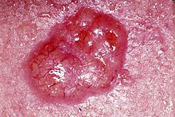
Example
Representational unit (class, concept, term): Melanoma
Member, instance: e.g. basal cell carcinoma at left cheek of patient #12334
Dependencies: every basal cell carcinoma is located in some skin
Upper level Categories:
Material entity?
Process?
both?
what is the ontological commitment of “basal cell carcinoma ”?

Slide 5
Ontological commitment
“Agreement about the ontological nature of the entities being referred to by the representational units in an ontology” (modified definition following Gruber 93)
Formal ontologies: subsumption and equivalence statements are either true or false
Problem: change of truth-value of axioms and sentences according to resulting competing interpretations
Example: Tetralogy of Fallot in SNOMED CT and ICD10

Slide 6
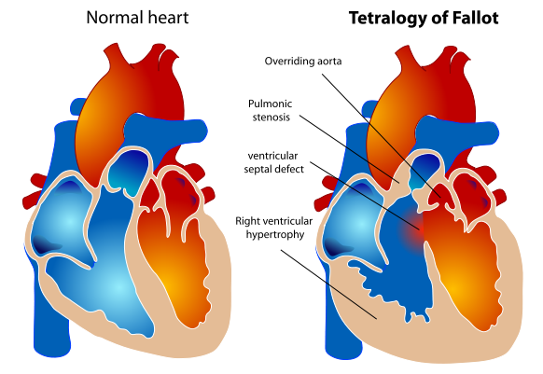
Tetralogy of Fallot

Slide 8
Every heart disorder that includes a defect of an interventricular septum structure is a ventricular septum defect.
Therefore tetralogy of Fallot is a kind of ventricular septum defect

Slide 9
Tetralogy of Fallot definition
SNOMED CT:
TetralogyOfFallot equivalentClass PulmonicValveStenosis and VentricularSeptalDefect and OverridingAorta and RightVentricularHypertrophy
TetralogyOfFallot is a child concept of VentricularSeptalDefect
ICD10:
Tetralogy of Fallot is a child of “congenital malformations of cardiac septa” and a sibling of “ventricular septal defect”

Slide 10
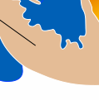
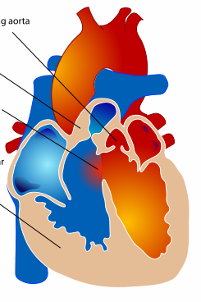
Proper parts or taxonomic parents ?
Example from Harold Solbrig
VSD PVS RVH OA
Red Light Yellow Light Green Light
is-a
is-a
is-a
is-a
is-a
is-a
is-a
Tetralogy of Fallot Traffic Light

Slide 11
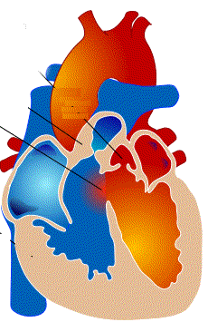
Ontological Commitment 1
Extension of “Ventricular Septal Defect ” includes extension of “Tetralogy of Fallot”: FALSE

Slide 12
Ontological Commitment 2
SNOMED CT concepts are instantiated by patients or clinical situations.
VentricularSeptalDefect stands for “Patient with a ventricular septum defect”
Tetralogy of Fallot stands for “Fallot Patient”
All Fallot patients are also patients with ventricular septum defect because every instance of Tetralogy of Fallot (pathologic structure) has one instance of ventricular septum defect as part
Consequence:
Finding and procedure concepts extend to classes of patients but not to classes of findings or procedures

Slide 13
Ontological Commitment 1
Extension of “Patient with Ventricular Septal Defect” includes extension of “Patient with Tetralogy of Fallot”: TRUE
V
F
V
V
F
V
F
F
V
V
V

Slide 14
Ontological Commitment 3
Extension of “Situation with Pulmonic Valve Stenosis” includes extension of “Situation with Tetralogy of Fallot”: TRUE
V
P
F
V
P
V
F
P
V
F
P
F
V
P
V
P
V
P

Slide 15
Problem
The same term can be used to denote pathological structures, patients, or situations
Difficulties with classes that have compositional objects as members To what extends “A with B”:
a mereological sum A + B?
A kind of A which is located in an organism which is also the location of some B ?
A kind of B which is located in an organism which is also the location of some A ?
the organism?
the situation?
Formal representation of complex SNOMED CT expressions.
Schulz S, Markó K, Suntisrivaraporn B.
BMC Med Inform Decis Mak. 2008 Oct 27;8 Suppl 1:S9.

Slide 16
Epistemic contexts
Pregnancy, not (yet) confirmed
Diarrhoea of presumed infectious origin
Atypical squamous cells of uncertain significance, probably benign
Natural death with probable cause suspected
Family history of dementia
Absent foot

Slide 17
both in SNOMED CT and ICD

Slide 18
both in SNOMED CT and ICD
Information entities, Diagnostic statements
Context-free representation of
diseases,disorders
Ontological core

Slide 19
Other example of conflicting meanings
Child
Sibling
Notes:
19

Slide 20
Conclusions
Many hierarchies and definitions SNOMED CT suggest that SNOMED CT’s ontological commitment is heterogeneous
SNOMED CT’s alternative commitments are completely implicit, thus leaving burden of interpretation to the user.
But the alternative interpretations shed light on clinicians’ reasoning
Both SNOMED CT and ICD10 mix elements of an ontology with elements of information models (information artifacts)

Slide 21
Third Intl. Conference on Formal Ontologies in Information systems (FOIS 2004)
http://lhncbc.nlm.nih.gov/lhc/docs/published/2004/pub2004064.pdf
Forthcoming in Applied Ontology

